Slide 1

TEHW 2026 EDUCATIONAL SEMINAR
Cigna DHMO
PRESENTED BY PAM SCANTLIN
Cigna Account Executive

Slide 2
TEHW 2026 Educational Seminar Agenda
DHMO Benefits
Find a Dentist
myCigna
Smart Scan
Oral Health Integration Program

Slide 3
Call or Click to Find a Network Dentist
Finding a Cigna Dental Care® network dentist or specialist is quick and easy. You can search online or call to speak with a customer service representative. Remember to always pick a network general dentist who’s within 25 miles of your location to ensure adequate access.
Here’s how – From myCigna.com – the easiest way
Once you are enrolled in a Cigna Dental Care plan, register at myCigna.com. The site will provide details about your plan. You can search for a dentist using your location, dentist name or procedure. You can narrow your search by using prompts on the results page.
On the go? Not a problem. This information is also on the myCigna® App.**
Cigna.com
To search for a dentist on Cigna.com, visit the site and click “Find a Doctor, Dentist or Facility.”
For a DHMO provider, follow the prompts and when asked to choose your plan, select “CIGNA DENTAL CARE DHMO”*
• Review the list by specialty, or, narrow your search by typing in provider name, specialty or office name.
Once you get your search results, you can further refine your search by: – Distance – Specialty – Years in practice – Additional languages
Click on a dentist’s name for more details. Such as office hours and location listings with map view.
Call us at 800.Cigna24 (800.244.6224) Need help finding a Cigna Dental Care network dentist or specialist? Just give us a call. You can use the automated Dental Office Locator. Or, you can speak directly with a customer service representative.
* The term DHMO (“Dental HMO”) is used to refer to product designs that may differ by state of residence of enrollee, including but not limited to, prepaid plans, managed care plans and plans with open access features. The Cigna Dental Care (DHMO) product availability varies by state and is subject to change.
** The downloading and use of the myCigna App is subject to the terms and conditions of the App and the online stores from which it is downloaded. Standard mobile phone carrier and data usage charges apply.

Slide 4
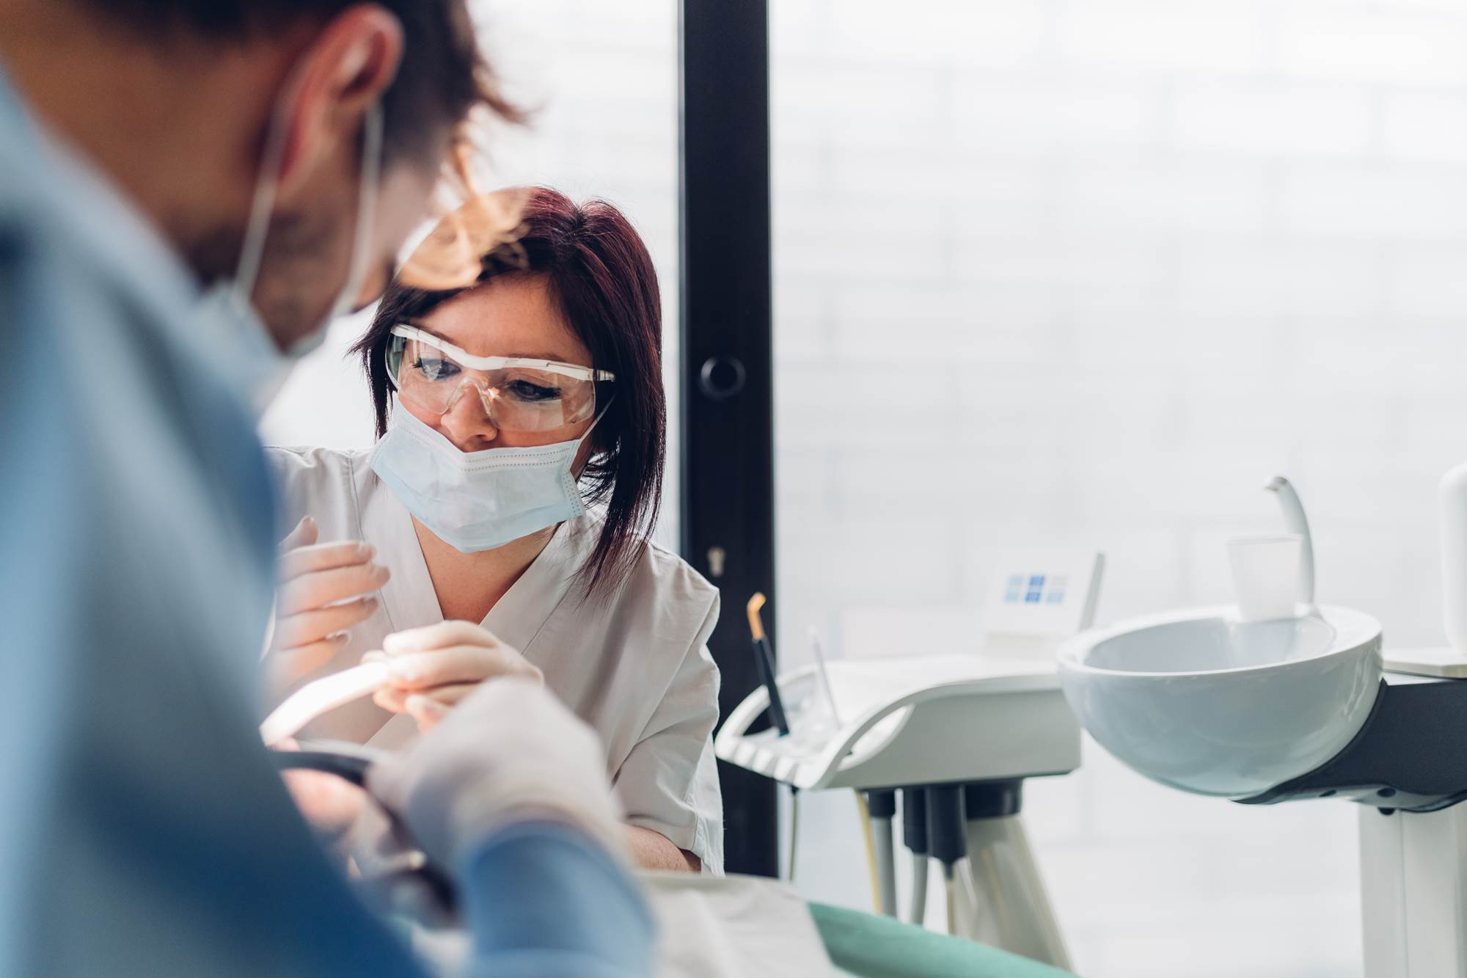
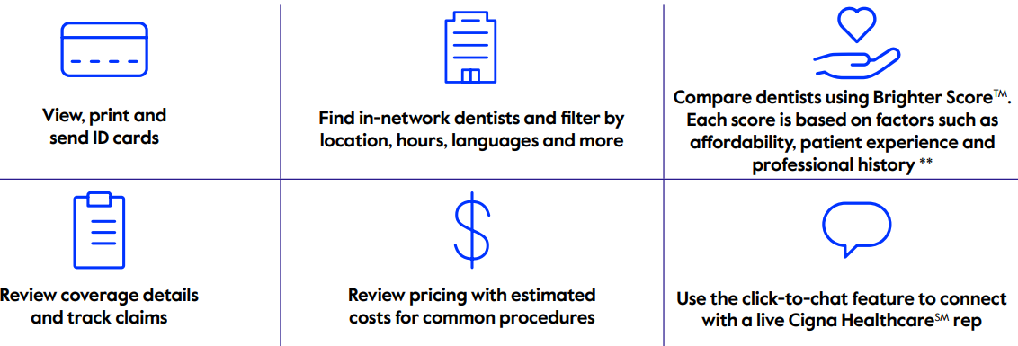

myCigna
So many ways to help manage your oral health - myCigna

Slide 5

SmartScan Keep your teeth in the picture of health
What is SmartScan?
SmartScan is a unique, at-home dental screening tool that lets you use your smartphone to take a series of guided dental photos. In a process overseen by Cigna Healthcare® network dentists, AI will analyze the photos and provide an assessment within minutes.
What SmartScan is not.
SmartScan is not a replacement for a full exam and x-rays done in a dental office, which are important ways to protect your teeth, gums and overall good health and diagnose problems early.
The many benefits of SmartScan.
SmartScreen screenings are available at no additional cost.
The process takes approximately five to ten minutes from start to finish.
You’ll get an understanding of your oral health status plus health tips on how to improve your oral health.

Slide 6
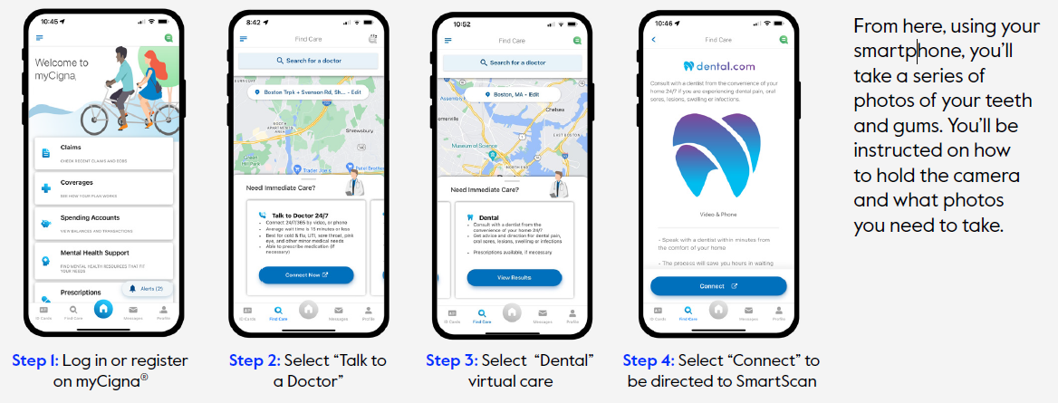
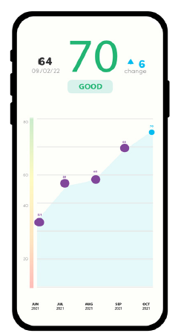
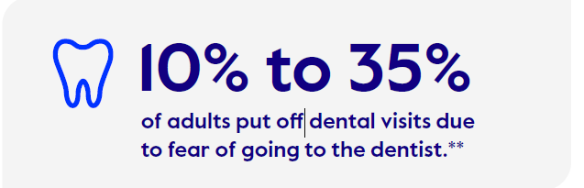
How to get started with SmartScan
Once completed:
• Your photos will be uploaded to Dental.com/cigna
• Each photo is analyzed through artificial intelligence (AI) to determine
potential areas of concern. Our Cigna Healthcare network dentists also
review scans to improve the accuracy of the AI engine.
• You will receive a report that includes an overall rating of green, yellow
or red, indicating your oral health status
• If your oral rating is green, you’ll have peace of mind knowing your mouth is
healthy. If your oral rating is yellow or red, you’ll have an opportunity to book
a tele dentistry appointment thorough Cigna Healthcare Dental virtual care,*
or be referred to a Cigna Healthcare Dental in-network provider.

Slide 7
Who Qualifies for OHIP?
To qualify you must have a dental plan with Cigna HealthcareSM and have been diagnosed by a doctor for any of the following conditions:
Heart Disease
Stroke
Diabetes
Maternity
Chronic kidney disease
Organ transplants
Radiation for head or neck cancers
Rheumatoid arthritis
Sjogren’s syndrome
Lupus
Parkinson’s disease
Amyotrophic Lateral sclerosis (ALS)
Huntington’s disease
Opioid misuse and addiction
You do not have to be enrolled in a Cigna Healthcare medical plan to be eligible for this program.
How do I enroll?
Enroll in the Cigna Dental Oral Health Integration Program by going to myCigna.com® > Coverage > Dental and filling out the registration form online. Or, call the number on your ID card and ask to be mailed a registration form.

Slide 8

Thank you for your time and attention

