Slide 1


Kaiser Permanente
Care for all that is you
Transit Employees Health and Welfare Plan (TEHW)

Slide 2


Why choose Kaiser Permanente?
High-quality, personalized care
From prevention to primary care to specialized care
With doctors who learn your lifestyle, health risks, and goals
Care teams connected to your
medical history through your
electronic health record
Convenient access
With 24/7 care by phone
or video¹
On one app that makes care
easy to manage
At facilities that offer more
services in one stop
Support for total health
Help with mental health concerns from any member of your care team
Self-care apps, classes, services, and programs^{2,3}
Resources to help you achieve your health and fitness goals
1. When appropriate and available. 2. The apps and services described above are not covered under your health plan benefits, are not a Medicare-covered benefit, and are not subject to the terms set forth in your Evidence of Coverage or other plan documents. The apps and services may be discontinued at any time. 3. Some classes may require a fee.
2
| ©2025 Kaiser Foundation Health Plan, Inc.

Slide 3



Care that’s personalized
You need a doctor who understands you. Someone who’ll learn your lifestyle, health risks, and goals.
At Kaiser Permanente, you don’t have to repeat yourself every time you visit the doctor. Your care team has access to your entire medical history through your electronic health record, so they know you and your story.
Care teams that make you feel comfortable
Access many clinicians who speak more than
one language.
Browse doctor profiles and change your personal
doctor anytime.
Find a doctor
who’s right for you.
3
| ©2025 Kaiser Foundation Health Plan, Inc.

Slide 4




Care that’s personalized (continued)
Connected by your electronic health record
Your health history lives in your electronic health record.
Your doctor guides you through appointments and referrals.
Your health record is available to you and your care
team 24/7.
Your care team lets you know when to schedule checkups and tests.
4
| ©2025 Kaiser Foundation Health Plan, Inc.

Slide 5
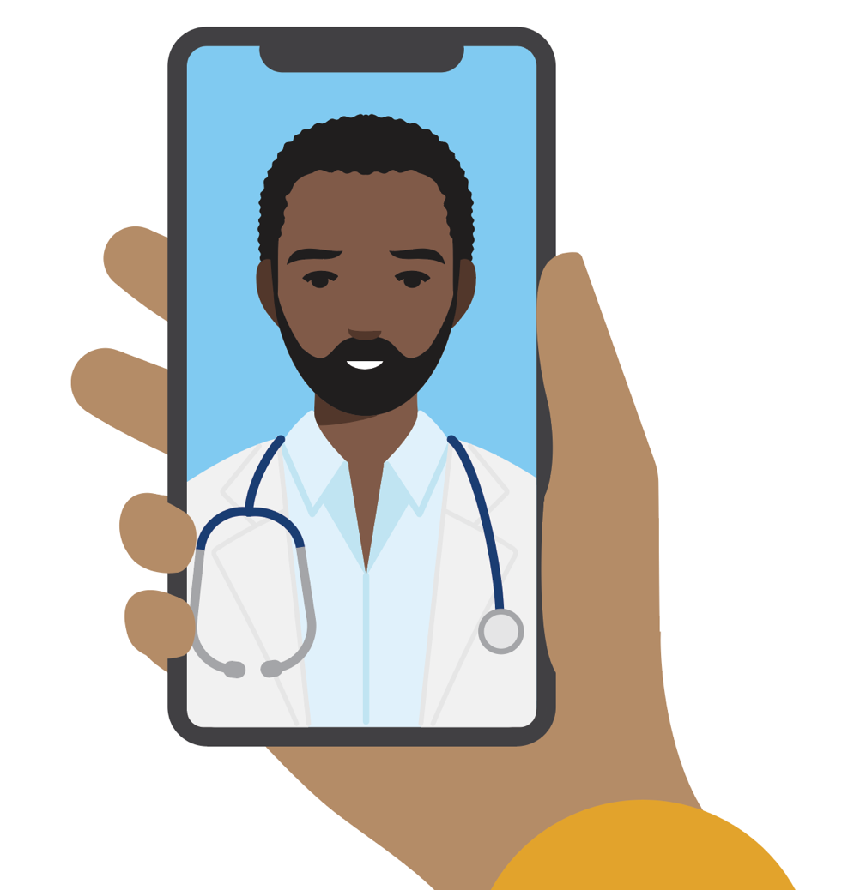



Care that’s convenient
We make it easy to get high-quality care when and where you
want it. No matter how you connect, you’ll always talk with a medical professional who can see your health history, so you never have to
repeat your story.
Your health at your fingertips
Get 24/7 care by phone or video.¹
Email your care team.
Schedule routine appointments.
View most lab results and doctor’s notes.
Refill most prescriptions.
Check in for appointments.
Pay bills and view statements.
Simplify your health care with
the Kaiser Permanente app.
Over half of members
avoided a trip to the ER
or urgent care with a video visit.²
1. When appropriate and available. 2. Kaiser Permanente internal data, 2023.
5
| ©2025 Kaiser Foundation Health Plan, Inc.

Slide 6




Convenient care close to home
Choose Kaiser Permanente doctors and facilities that are close to work or home. Wherever you visit, your care team is connected to a national network of specialists and services.
Most members same they get primary care appointments as soon as they expect—or sooner at most Kaiser Permanente locations.
You can get convenient service with:
Timely primary care appointments
24/7 virtual care
Quick lab results
1,800+ physicians
Find locations that are close to home.
6
| ©2025 Kaiser Foundation Health Plan, Inc.

Slide 7
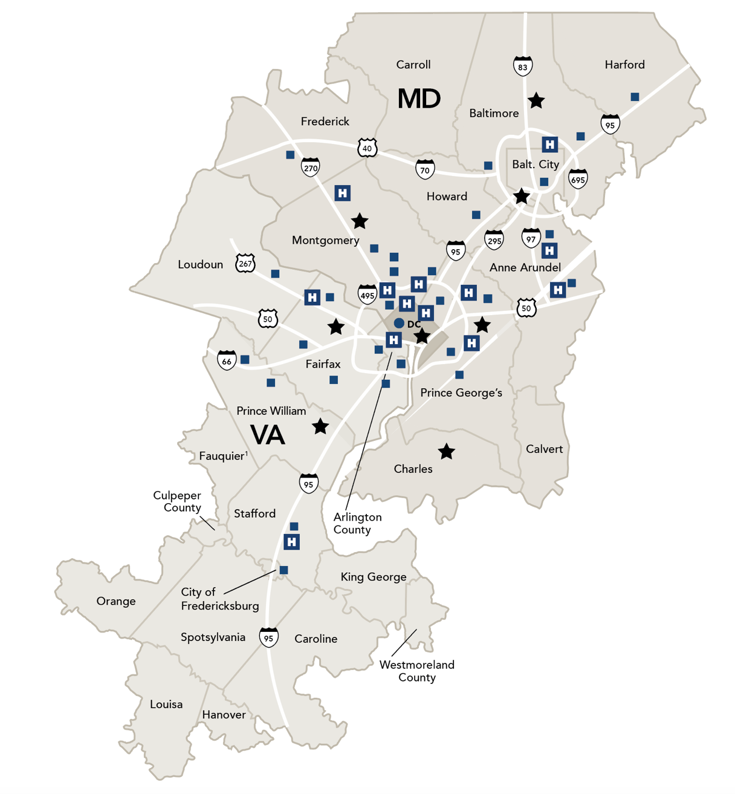
Service areas in Mid-Atlantic
States
Portions of Caroline, Fauquier, Hanover, Louisa, Orange, and Westmore counties
Washington, D.C
Maryland
Anne Arundel County
Baltimore County
Carroll County
Harford County
Howard County
Montgomery County
Prince George’s County
City of Baltimore
Portions of Calvert, Charles, and
Frederick counties
Virginia
Arlington County
Fairfax County
King George County
Loudoun County
Prince William County
Spotsylvania County
Stafford County
Cities of Alexandria, Fairfax, Falls Church, Fredericksburg, Manassas, and Manassas Park
Upcoming Medical Center
Medical Center
Medical center with 24/7 Advanced Urgent Care, lab, pharmacy, and radiology
¹Not in the Kaiser Permanente Medicare Advantage (HMO) service area.
7
| ©2025 Kaiser Foundation Health Plan, Inc.

Slide 8




Convenient care while traveling
Planning a trip? Have a child going away to college? Before you leave, we’ll help you get vaccinated, refill prescriptions, and stay on top of your health while you’re away.
You’re covered for urgent and emergency care
anywhere in the world.
You can always get 24/7 care by phone or online across the U.S.*
Learn more about getting
care away from home.
*When appropriate and available. If you travel out of state, phone appointments and video visits may not be available in select states due to licensing laws. Laws differ by state.
8
| ©2025 Kaiser Foundation Health Plan, Inc.

Slide 9


Resources for mental health
Members can get help with depression, anxiety, addiction, and mental or emotional health — without a referral for mental health care within Kaiser Permanente. Share your concerns with anyone on your care team at any time, and they can connect you to the support you need.
Individual or group therapy
Health classes¹
Medication
Online resources
Apps for mental wellness and self-care²
Not sure where to start? Talk to your personal doctor about your concerns or call us to talk with our mental health team.
Find mental health and wellness resources
that fit your life.
1. Some classes may require a fee. 2. The apps and services described above are not covered under your health plan benefits, are not a Medicare-covered benefit, and are not subject to the terms set forth in your Evidence of Coverage or other plan documents. The apps and services may be discontinued at any time.
9
| ©2025 Kaiser Foundation Health Plan, Inc.

Slide 10





Resources for everyday wellness
Take advantage of classes, services, and programs to help you achieve your health and fitness goals.¹
Reduced rates on gym memberships
Wellness coaching by phone
kp.org/wellnesscoach
Healthy lifestyle programs and classes²
kp.org/healthylifestyles
Online fitness classes
kp.org/classes
1. These services aren’t covered under your health plan benefits and aren’t subject to the terms set forth in your Evidence of Coverage or other plan documents.
These services may be discontinued at any time without notice. 2. Some classes may require a fee.
10
| ©2025 Kaiser Foundation Health Plan, Inc.

Slide 11
Transit Employees Health and Welfare Plan (TEHW) HMO Signature Plan
This table shows an example of some of your group’s benefits.*
Benefits | Details
Yearly deductible | $0 individual/$0 family
Maximum yearly out-of-pocket costs | $1,000 individual/$2,000 family
Covered services | You pay
Preventive care | $0 copay
Doctor’s office visit (PCP or Specialist) | $15 copay
Lab tests and radiology | No charge
Outpatient surgery | $15 copay
Urgent Care | $15 copay
Hospitalization | No charge
Emergency care | $50 copay
Ambulance | No charge
Hearing Aids | $0 copay (1 hearing aid per ear every 36 months)
Prescribed medications (30-day supply) 90-day supply: 3 copay; 2 copay for mail order | $10 copay (generic medication)/$25 copay (brand-name medication)/$40 (specialty medication)
* This is a summary of some benefits and their copays and coinsurance. For specific information about your covered health plan benefits, limitations,
and exclusions, including those not listed in this summary, please see your Evidence of Coverage.
11
| ©2023 Kaiser Foundation Health Plan, Inc.

Slide 12

Thank you
12
| ©2025 Kaiser Foundation Health Plan, Inc.

