Slide 1
Find your healthy place
With care designed to help you thrive
Kaiser Permanente Medicare Advantage Plan
Transit Employees Health and Welfare Plan (TEHW)
Darrien Banks, Senior Group Medicare Retiree Consultant
Notes:
Hello, and welcome Howard County Government employees and retirees. My name is Tanya Robinson, and I am the Executive Director of MEdicare Kaiser Permanente, and I am very excited to go over the Medicare Advantage plan that is available to you. Today we are going to be going over our Kaiser Permanente model, go over the benefits of the plan and talk through some of the added features as well. I want to highly encourage you to ask questions, so please feel free to use the chat, and we will make sure that all of your questions get answered. Lastly since we are in a public forum, if your question is pertaining to PHI please contact your benefits department who will be able to assist you. With that being said lets go ahead and get started.

Slide 2









Integrated care centered around you
KAISER PERMANENTE MEDICARE HEALTH PLANS
Primary care
Health
plan
Specialty care
Quality care begins with our integrated care delivery system, which offers you:
Care and coverage together in one package
A coordinated, connected care team
Many convenient services under one roof
Digital
care options
Pharmacy and labs
Connected care team
Electronic health data
Notes:
We combine care and coverage — which makes us different than your other health care options. With Kaiser Permanente, you get:
Connected care — We’re both a care provider and a health plan, which makes your life easier. Your doctors, hospitals, and health plan work together — making it more convenient for you to get the right care when you need it. Your personal doctor, specialists, and nurses are connected to each other, and to you, through our electronic health record system. You get personalized care, because they can see your health history — like your conditions, medications, and allergies. At most of our centers you can get your labs done, visit your primary and specialist doctors, get xrays completed and pick up prescriptions all without leaving the building.

Slide 3






KAISER PERMANENTE MEDICARE HEALTH PLANS
Your care, your way
With Kaiser Permanente, you can get care when, where, and how you want it.
Video Visits*
Connect with your doctor online. It’s convenient, safe, and secure, and it often doesn’t require a copay.
In person Same-day appointments
may be available.
Phone
Schedule a telephone appointment and get advice 24/7.
Email
Message your doctor anytime with
nonurgent questions.
App
Download our app to schedule appointments, manage prescriptions, see test results, and more.
*When appropriate and available.
.
Notes:
At Kaiser Permanente there are several ways that you can access care. We’re using technology to give you more convenient ways to get care. When you need care, you can have an appointment in person and same day appointments may be available. You can also schedule a phone visit, speak with a nurse on our 24/7 nursing advice line or securely email your doctor. Whether it is your regular primary care physician, or another one that is available they will have access to your health history so you will not have to go over your medical information again, and as mentioned on the previous slide this makes getting care easier and faster. Now let me tell you about a personal story that talks about how our integrated model helped me thrive. (share personal story)
Lastly, I want to highly suggest that you download the Kaiser Permanente App. With the app you can schedule appointments, manage prescriptions, see test results and much more so if you have not downloaded the app I highly suggest you do so because it is a another great tool to help manage your care

Slide 4




Added support to help you thrive¹
KAISER PERMANENTE MEDICARE HEALTH PLANS
Wellness coaching by phone
On-site health education classes and support groups
Online healthy lifestyle programs, videos, podcasts, recipes, and more
Find convenient
Kaiser Permanente care near you at kp.org/facilities
¹These services aren’t covered under your health plan benefits and aren’t subject to the terms set forth in your Evidence of Coverage or other plan documents. These services may be discontinued at any time without notice. The products and services described above are neither offered nor guaranteed under our contract with the Medicare program. In addition, they are not subject to the Medicare appeals process. Any disputes regarding these products and services may be subject to the Kaiser Permanente grievance process.
Notes:
There are some additional features available through Kaiser Permanente that help you thrive. This includes wellness coaching by phone, on site health education classes and support groups and online healthy lifestyle programs, videos, podcasts and much more. You can find resources in relation to eating healthy, quitting smoking, getting healthy amount of sleep and much more. You can also find a location near you by visiting kp.org/facilities.

Slide 5
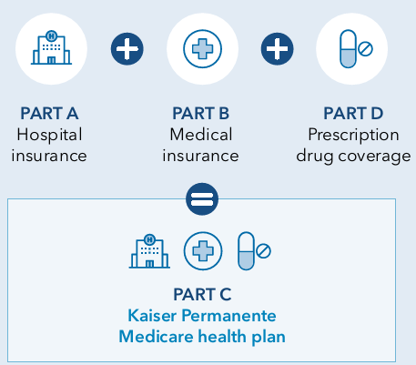
MANAGING RETIREE HEALTH CARE COSTS
Kaiser Permanente Medicare Advantage Plan
To enroll into the Kaiser Permanente Medicare Advantage plan
You must be enrolled into Medicare Parts A and B through Social Security first and live within the Medicare Advantage Service Area
Privileged & Confidential
Notes:
Now that we have talked about the Kaiser Permanente integrated model lets now focus on the KP MAPD plan information and benefits. To enroll into the Kaiser Permanente Medicare Advantage Plan you much be enrolled into Medicare Parts A and B through Social Security first and live within the Medicare Advantage Service area, (repeat this statement again). After enrollment has been accepted into Medicare, you must also complete the Kaiser Permanente Group Application, in addition to what Howard County Government may require you to do. We suggest that for members who are getting ready to retire, and are reaching Medicare eligibility or are already eligible, that they start the process of contacting social security 3 months prior to their retirement to allow time to get Parts A and B and complete the necessary steps from an employer perspective and help ensure a smooth transition. The picture on the right displays a depiction of our Medicare plans which include Part A hospital Insurance, Part B medical insurance and Part D prescription drug coverage all in one comprehensive plan, with a few healthy extras included.

Slide 6




Summary of Benefits (1/1/25–12/31/25)
KAISER PERMANENTE MEDICARE HEALTH PLANS
Services | TEHW
Annual Out-of-Pocket Maximum | $3,400
Part D Out-of-Pocket Maximum | $2,000
Office Visits | $15 per visit
Lab/X-rays | No charge
Outpatient Hospital Coverage | $15 per visit
Hospitalization Services | No charge
Emergency Services | $50 per visit
Ambulance Services | No Charge
This is just a summary. For more information, please review the applicable Evidence of Coverage at kp.org/eoc.
Notes:
This is now showing a snapshot of the medical benefits on the plan. If you are looking for more detailed information you can reference our summary of benefits, and applicable EOC when that information becomes available. Additionally, this plan has a $0 deductible meaning that you are only responsible for the applicable copay for each visit.
Provide an example of someone who had a primary care visit because they were experiencing pain and had to get an x-ray. Can talk about how they can do this all in one visit.

Slide 7
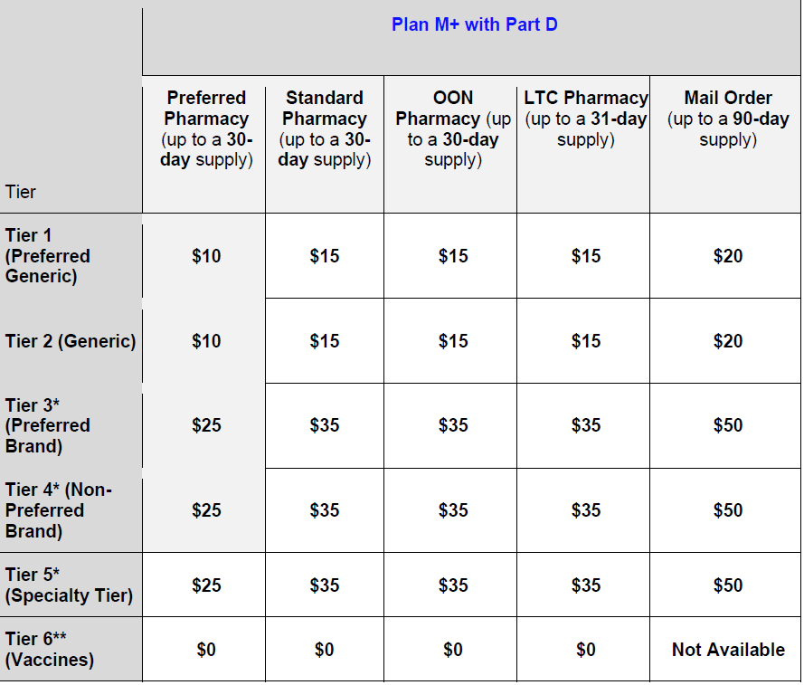
Summary of Benefits- Prescription Drug Coverage (1/1/25–12/31/25)
The Transit Medicare Advantage Plan includes Part D prescription drug coverage
Kaiser Permanente is implementing a new program required by CMS that will offer members the option to spread payments of Medicare Part D-covered prescription drugs over the calendar year. This program, called the Medicare Prescription Payment Plan
Notes:
The Howard County Government plan also includes prescription drug coverage and for 2025 the Part D out of pocket threshold has been reduced to $2,000 as a result of the Inflation Reduction Act, meaning that if you pay more than $2,000 out of pocket for prescription drugs you will not be responsible for paying anything else out of pocket for the plan year for Part D prescription drugs. Additionally, Kaiser Permanente is implementing a new program required by CMS that will offer members the option to spread payments of Medicare Part D-covered prescription drugs over the calendar year. This program, called the Medicare Prescription Payment Plan.

Slide 8
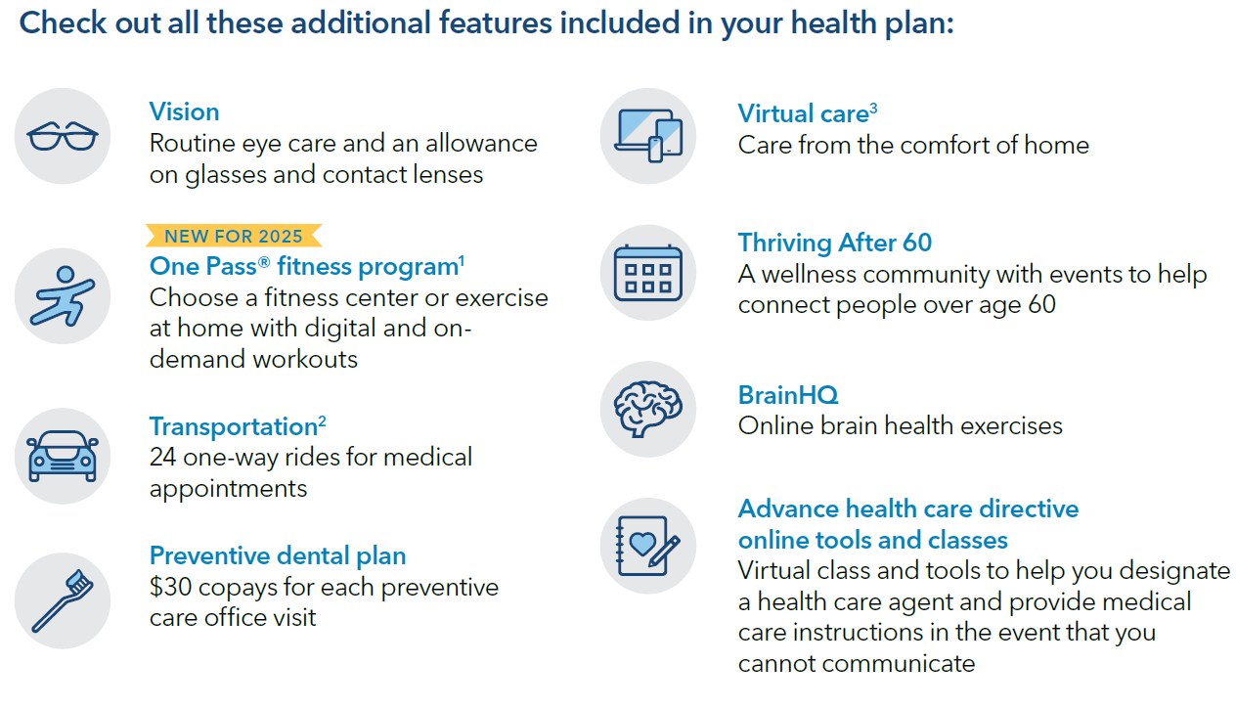
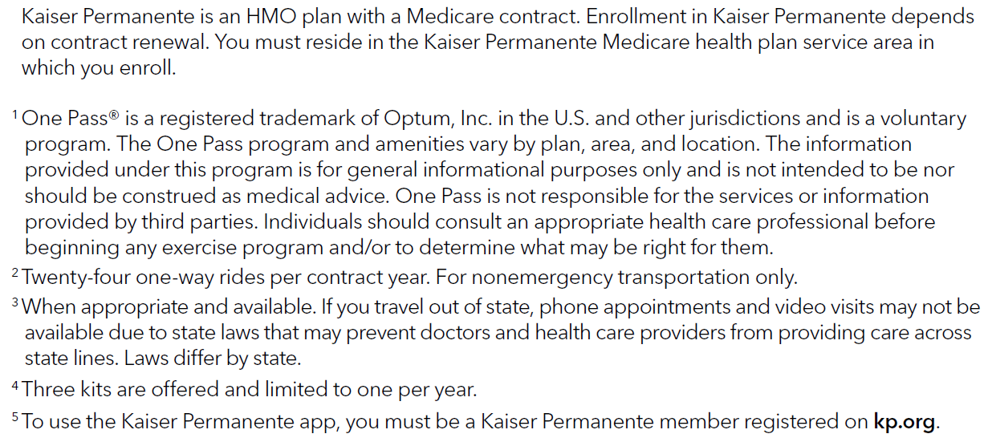
MANAGING RETIREE HEALTH CARE COSTS
Notes:
As a Medicare Advantage plan, we are required to offer all of the benefits under Medicare Parts A and B, but we also go above what original Medicare offers. In the next couple of slides, I will go into details about some of these added benefits. The benefits include (read slide)

Slide 9
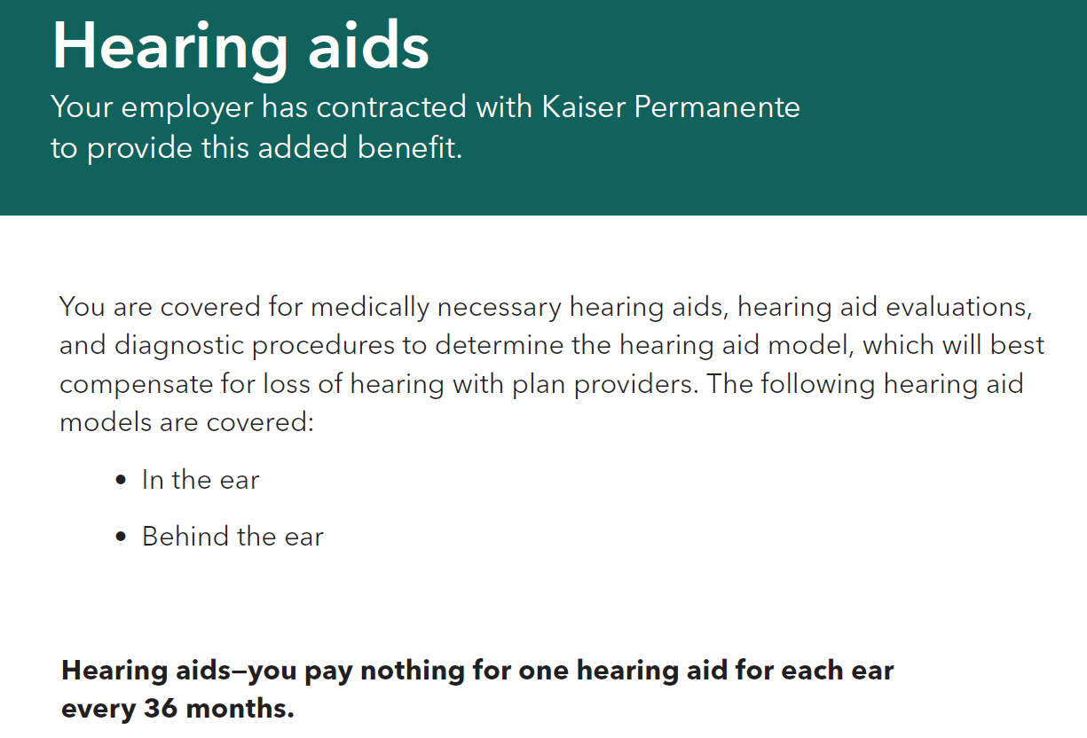

Slide 10

Notes:
You may have been receiving mail, phone calls, and seen ads on the TV regarding Medicare options that are available to you ecspecailly at this time during the year. It is important to note that you can only be enrolled in one Medicare Advantage plan at a time, and if you were to enroll into an alternative plan while enrolled on group sponsored coverage your group coverage plan will be terminated, and you may not be able to re enroll, so if you are thinking about making any changes, I suggest that you reach out to you benefits department prior to doing so to ensure that you understand all the implications of making this change.
We have seen members who have been employed by organizations for over 15+ years and decide to enroll into and individual plan and did not realize what the implications would be. They not only had a change in their copay structure but also they were not longer receiving their contributions due to their years of service. So again, while it is important to find a plan that fits your needs it is also very important that if you are thinking about making changes that you contact your benefits department prior to doing so to ensure you understand the full implications that a change could have on your coverage.

Slide 11

THANK YOU
for your time today!
KAISER PERMANENTE MEDICARE HEALTH PLANS
Questions?
For additional questions call our Medicare Member Services Line at (888) 777-5536 or visit Kp.org
Kaiser Permanente is an HMO plan with a Medicare contract. Enrollment in Kaiser Permanente depends on contract renewal. You must reside in the Kaiser Permanente Medicare health plan service area in which you enroll.
August 2024
Notes:
Thank you for your time today, and thank you to Howard County Government for allowing us to participate in todays session. At this time, we will take any questions,so please feel free to put those in the chat or unmute yourself.

