Slide 1

TEHW
2025 EDUCATIONAL
SEMINAR
DHMO

Slide 2

TEHW Cigna DHMO BENEFITS
Cigna Dental Care® (DHMO)
Your Cigna Dental Care (DHMO) plan is a copayment plan.
  You pay a fixed portion of the cost, as listed in your Patient
  Charge Schedule. Your plan pays the rest.
Remember to choose an in-network dentist, who can refer you to
a specialist, if needed. Children can remain with a pediatric
dentist until their 13th birthday.
Change your Cigna Dental Care network general dentist
  (NGD) anytime. Go online to select your NGD or call customer
  service. Changes made by the 15th will be effective the first of
  the following month. If you need an urgent change, customer
  Service is available to help 24/7.
There’s no annual deductible or calendar year maximum.

Slide 3
Call or click to find a network dentist.
It’s easy with Cigna Dental Care (DHMO)*
Finding a Cigna Dental Care® network dentist or specialist is quick and easy. You can search online or call to speak with a customer service representative. Remember to always pick a network general dentist who’s within 25 miles of your location to ensure adequate access.
Here’s how – From myCigna.com – the easiest way
Once you are enrolled in a Cigna Dental Care plan, register at myCigna.com. The site will provide details about your plan. You can search for a dentist using your location, dentist name or procedure. You can narrow your search by using prompts on the results page.
On the go? Not a problem. This information is also on the myCigna® App.**
Cigna.com
To search for a dentist on Cigna.com, visit the site and click “Find a Doctor, Dentist or Facility.”
Follow the prompts and when asked to choose your plan, select “CIGNA DENTAL CARE DHMO”
• Review the list by specialty, or, narrow your search by typing in provider name, specialty or office name.
Once you get your search results, you can further refine your search by: – Distance – Specialty – Years in practice – Additional languages
Click on a dentist’s name for more details. Such as office hours and location listings with map view.
Call us at 800.Cigna24 (800.244.6224) Need help finding a Cigna Dental Care network dentist or specialist? Just give us a call. You can use the automated Dental Office Locator. Or, you can speak directly with a customer service representative.
* The term DHMO (“Dental HMO”) is used to refer to product designs that may differ by state of residence of enrollee, including but not limited to, prepaid plans, managed care plans and plans with open access features. The Cigna Dental Care (DHMO) product availability varies by state and is subject to change.
** The downloading and use of the myCigna App is subject to the terms and conditions of the App and the online stores from which it is downloaded. Standard mobile phone carrier and data usage charges apply.

Slide 4

Oral Health Integration
Program (OHIP)
What is OHIP?
    OHIP is a Cigna Dental Health Connect® solution –
    A no additional cost program for people with certain
    medical conditions that lead to a higher risk of oral
    health issues. If you qualify and participate in the
    program, you’ll get reimbursed for out-of-pocket
    costs for preventive dental treatments to treat
    issues such as gum disease and tooth decay.*
    Plus, you can get guidance on everything from
    overcoming dental anxiety to understanding the
    impact of tobacco.
    *Reimbursement will apply to and is subject to your annual benefits maximums.

Slide 5
Who Qualifies for OHIP?
To qualify, you must have a dental plan with Cigna Healthcare and have been diagnosed by a doctor for any of the following conditions:
Heart Disease
Stroke
Diabetes
Maternity
Chronic kidney disease
Organ transplants
Radiation for head or neck cancers
Rheumatoid arthritis
Sjogren’s syndrome
Lupus
Parkinson’s disease
Amyotrophic Lateral sclerosis (ALS)
Huntington’s disease
Opioid misuse and addiction
You do not have to be enrolled in a Cigna Healthcare medical plan to be eligible for this program

Slide 6
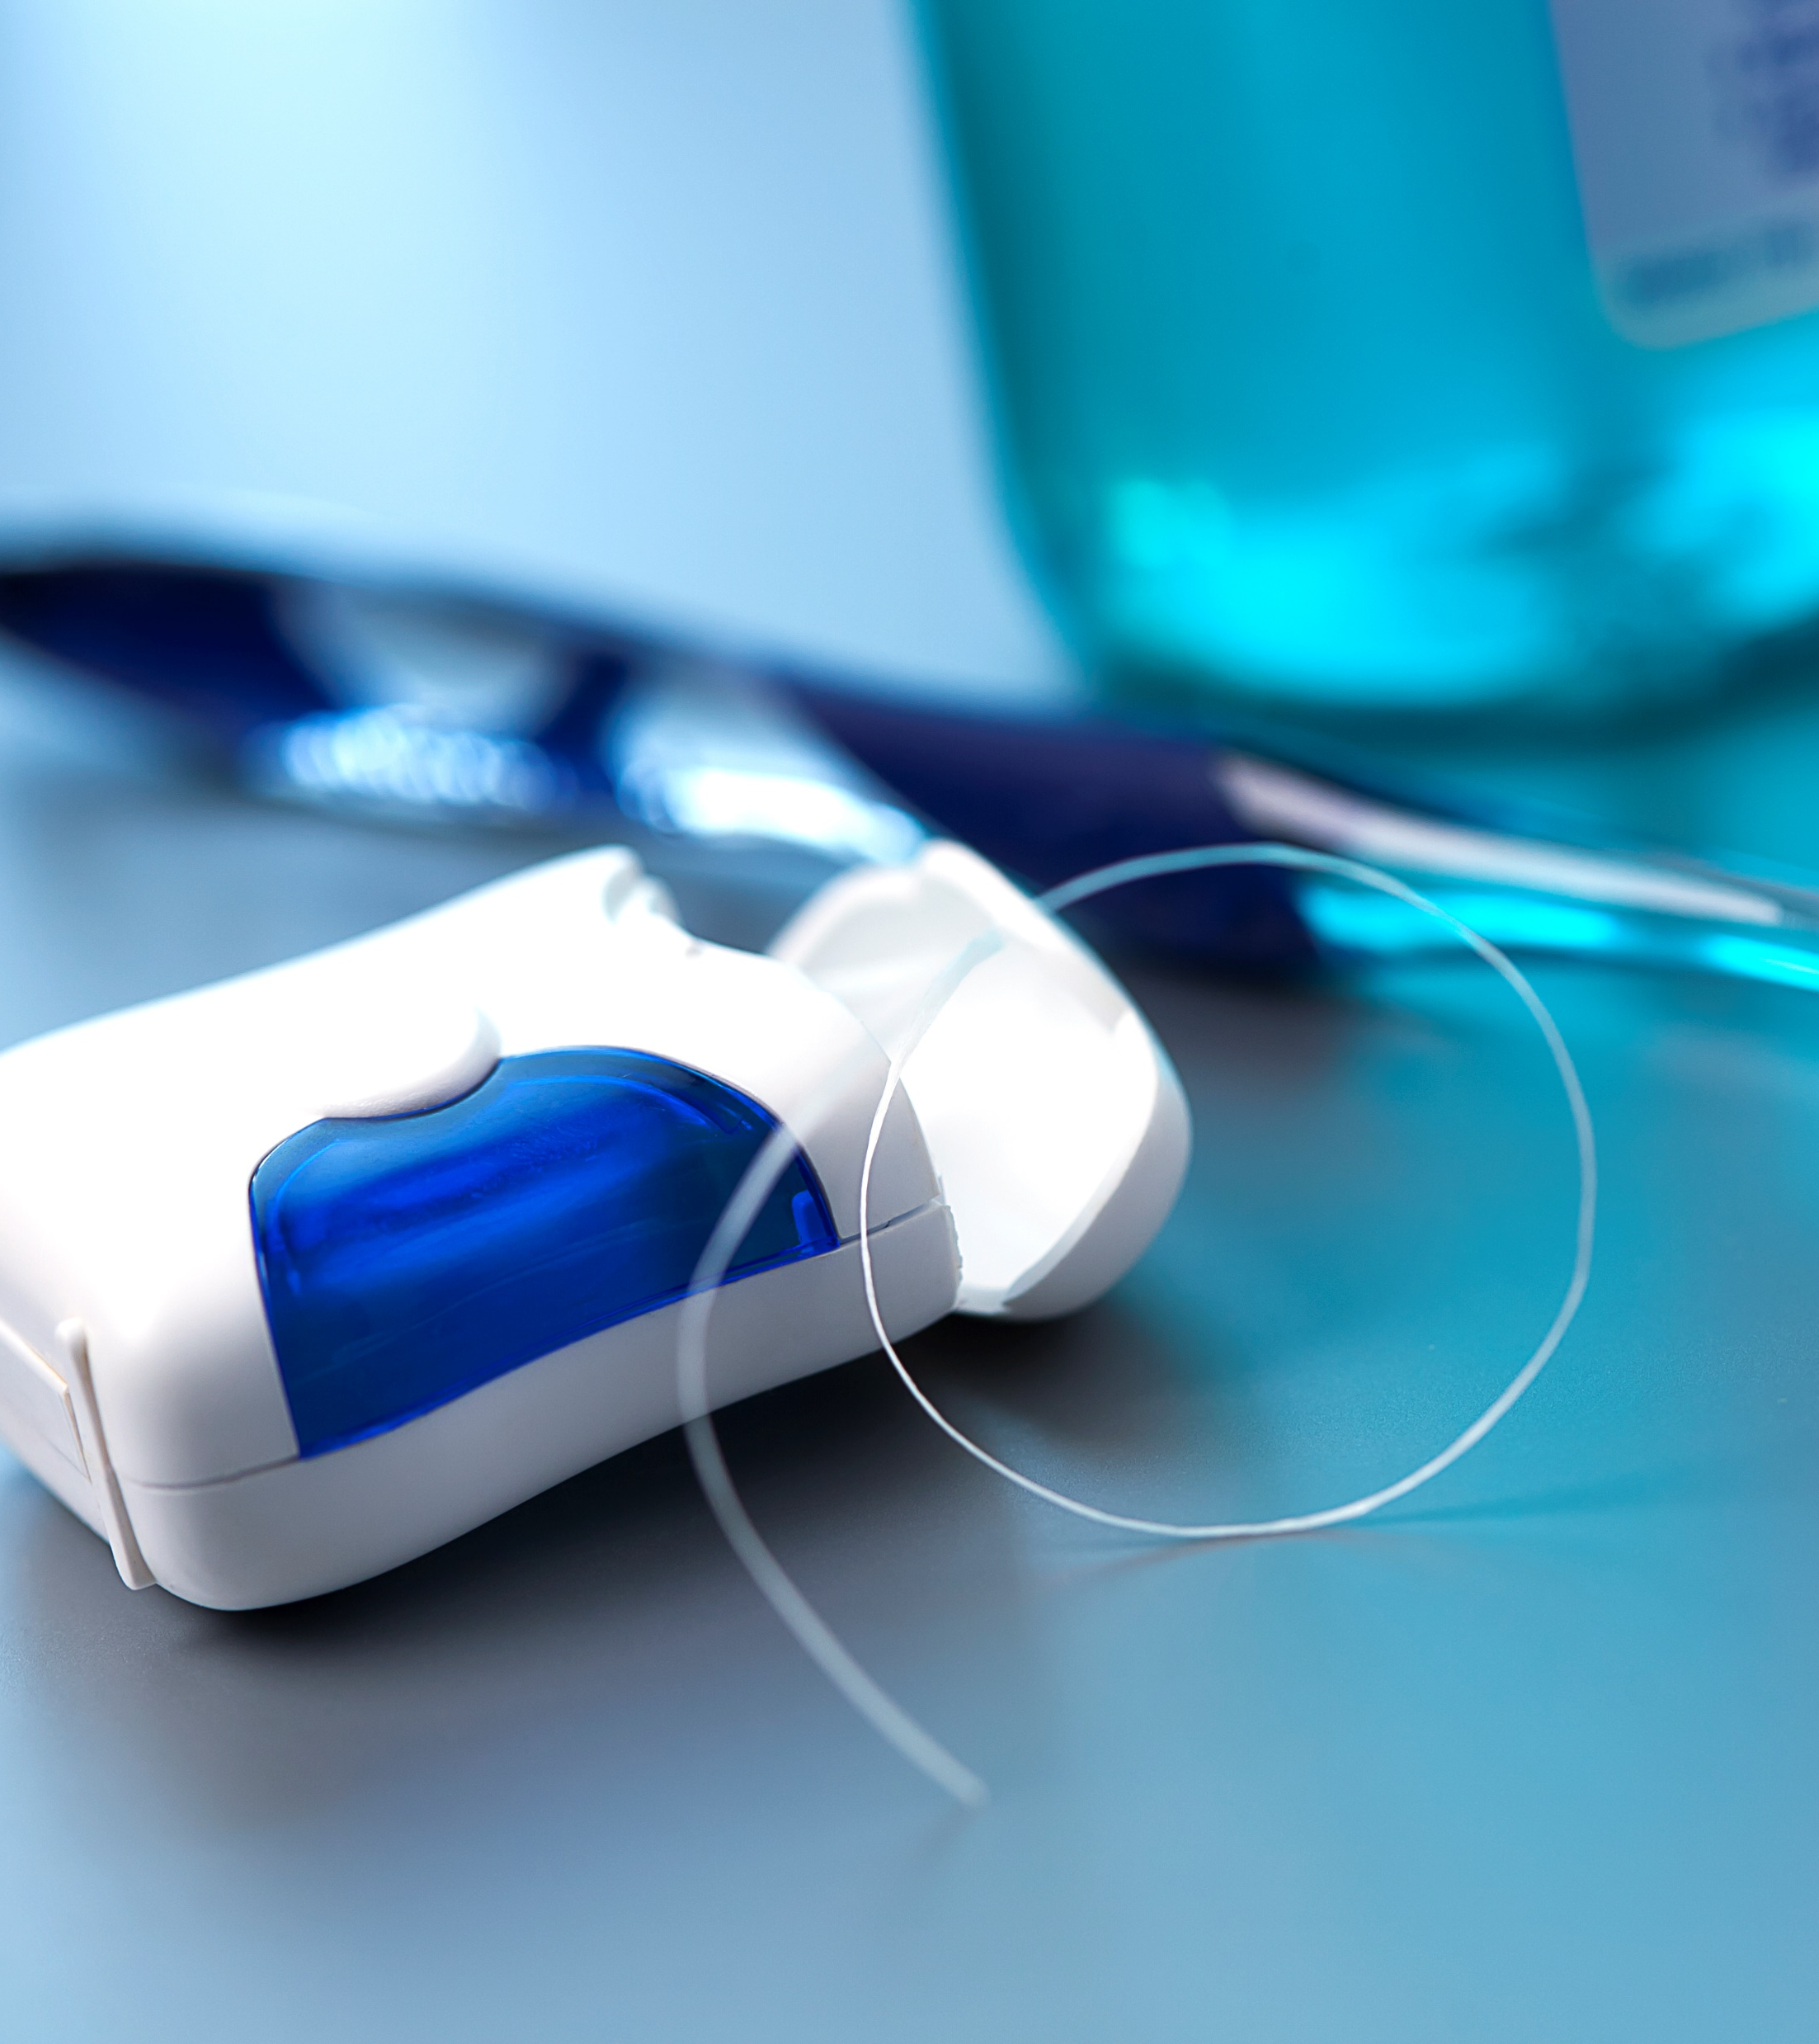
Thank you for your time!

