Slide 1
Tehw Educational seminar
March 22, 2025

Slide 3
Medical Products
Blue Choice HMO
Blue Choice Advantage with PPO Overlay
BlueVision Plus
Medicare Advantage
Preferred Dental
Preferred Dental with Ortho
Notes:
Master slide: Title and Three Column Content

Slide 4
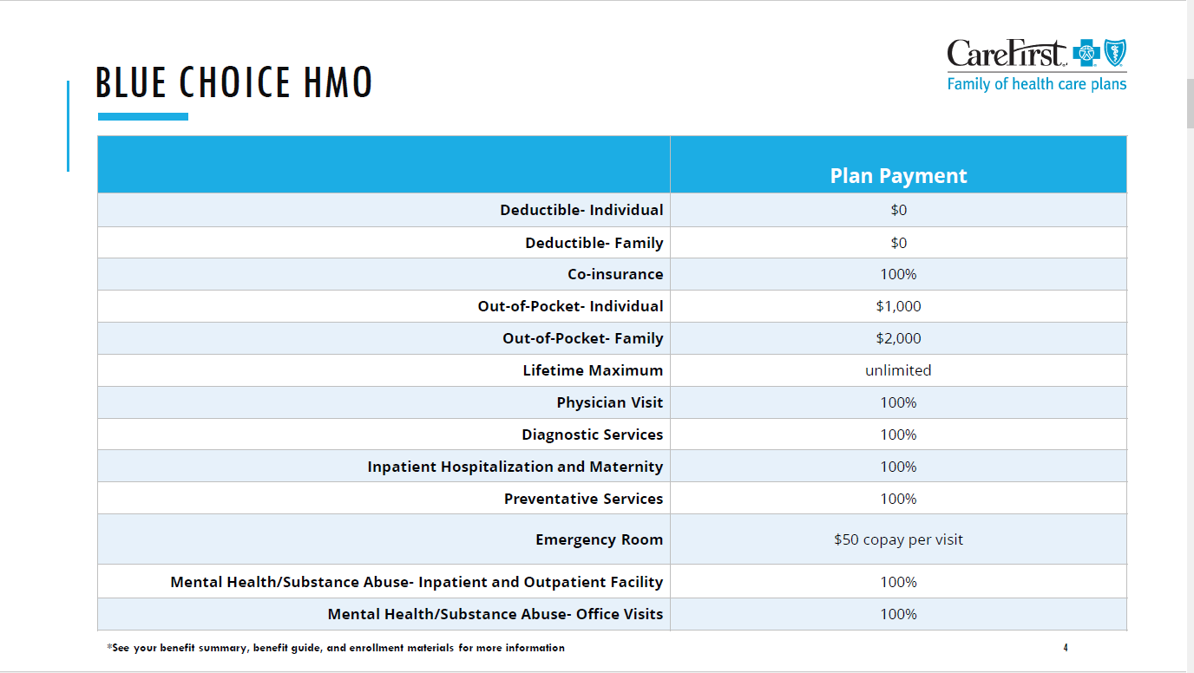

Slide 5
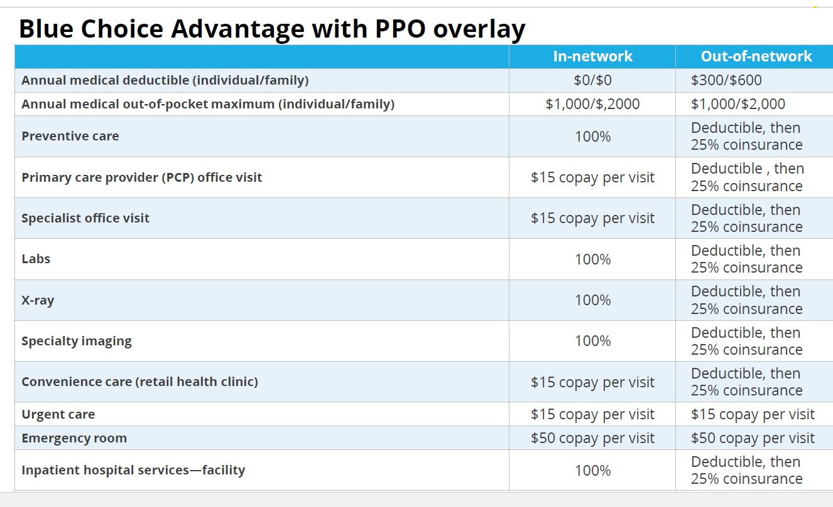

Slide 6
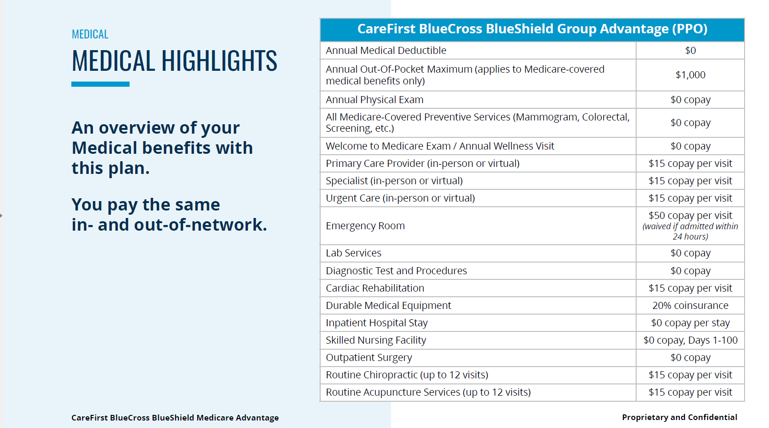

Slide 7

VISION
CareFirst BlueCross BlueShield
Proprietary and Confidential

Slide 8
VISION BENEFIT CHART
BlueVision Plus | In-Network | Out-of-Network
Eye Exam Once per 12-month benefit period | No Copay | Plan pays $35, you pay balance
Frames Two pairs of eyeglasses or two pairs of contact lens or one of each (Once per 12-month benefit period )
Davis Vision Frame Collection | No Copay for over 200 frames | Not applicable
Non-Collection Frame | Plan pays up to $200, you pay balance minus 20% discount | Plan pays $45, you pay balance
Spectacle Lenses Once per 12-month benefit period includes second pair benefit
Basic Single Vision | No Copay | Plan pays $25, you pay balance
Basic Bifocal | No copay | Plan pays $45, you pay balance
Basic Trifocal | No Copay | Plan pays $75, you pay balance
Contact Lenses Initial supply; once per 12-month benefit period
Medically Necessary Contacts | No copay with prior approval | Plan pays $200, you pay balance
Davis Vision Contact Lens Collection | No copay | Not applicable
Other (non-Collection) Contact Lenses | No copay | Plan pays up to $112.50
Laser Vision Correction | Up to 25% off allowed amount or 5% off any advertised special These discounts are not considered covered benefits under the Plan. This portion of the Plan is not an insurance product. Additional plan discounts may not be available at all provider locations in all states. Please confirm that discounts are accepted when making your appointment. Discounts are not insurance and subject to change without notice.
Notes:
The BlueVision Plus plan has a 24-month benefit period for Eye Exams, Frames, and Lenses.
There is In and Out of Network coverage.
It is always best to utilize In-Network providers to avoid balance billing. You will incur more out of pocket expenses with Out-of-Network/non-participating providers. Providers that are not within our network do not have to accept CareFirst’s allowed amount and can bill you for the remaining balance. So, it is always best to stay In-Network if possible

Slide 9
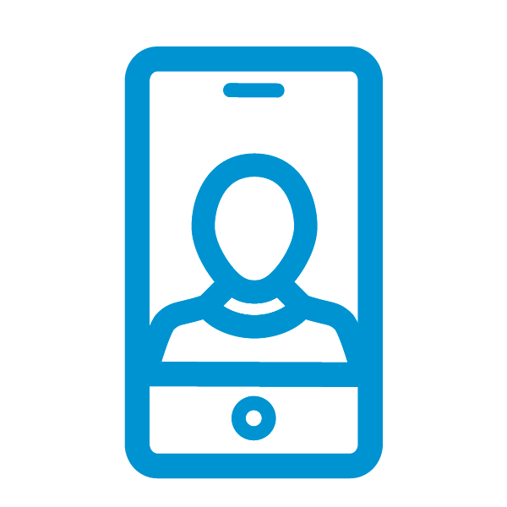





CLOSEKNIT
CloseKnit, our leading virtual care practice, gives you 24/7 access to the support you deserve—from primary and urgent care to therapy and more* through your desktop or the convenient CloseKnit mobile app.
Learn more and register at closeknithealth.com.
Primary Care
Full-service primary care from a dedicated care team.
For adults age 18+.
Urgent Care
The care you need to treat minor injuries and illnesses fast. Average wait time is 30 minutes or less.
For adults and children (age 2+).
Behavioral Health Services
Expert help, including therapy for depression, anxiety or other behavioral health diagnoses.
Psychiatric services coming soon.
Lactation Support
Assistance for nursing mothers with breastfeeding challenges.
Coming soon.
Diet & Nutrition
Guidance and support for healthy eating, weight loss and more.
Coming soon.
* Providers will use their professional judgment to determine if a telemedicine visit is appropriate or if an in-person visit is required.
CloseKnit is a registered trademark owned by and is the trade name of Atlas Health, LLC, which is a corporate affiliate of CareFirst of Maryland, Inc. and Group Hospitalization and Medical Services, Inc., which do business as CareFirst BlueCross BlueShield.

Slide 10









Whole health services
The virtual-first model offers preventive and urgent care, behavioral and mental health, chronic condition prevention, medication management and more.
A one-stop shop
Care teams treat most illnesses virtually and provide in-person care through connection to local providers when needed.
Continuous and Connected Care That is Centered Around You.
Care coordination & support
In addition to primary care, CloseKnit offers support for member’s whole health including coordinating care, appointment scheduling and enrollment support.
Insurance navigation assistance
Trust and financial security are important to a member’s overall health too. CloseKnit teams assist with insurance navigation, billing questions and education.
Open 24/7/365
Through a convenient, easy-to-use app. Just open the app and tell us what’s going on. We’re here for you, 24/7/365, with immediate availability for appointments.
Dedicated care teams
CloseKnit’s patient-centric care teams are focused on a member’s whole health. They combine mental and physical patient care to deliver a better overall total health experience.
Only the best care
Providers are thoroughly vetted. Each provider must go through a rigorous credentialling process. And adhere to the highest clinical standards.
True transparency
True cost transparency means no billing surprises. Members will know what things cost ahead of time.
Proprietary and Confidential
3

Slide 11
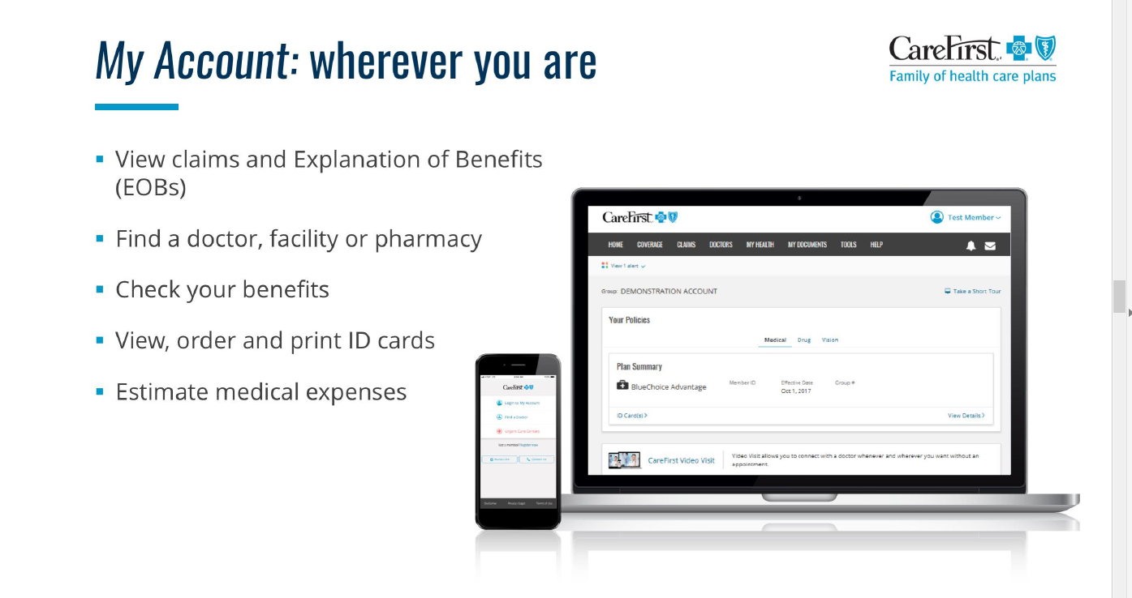

Slide 12

CAREFIRST WELLBEING
Notes:
Thanks, Emma! and hello everyone! Thanks for joining today
My name is Stephanie Freeburger and I’m a wellbeing consultant here at CareFirst.
Today I’m going to walk you through the CareFirst WellBeing app and show you how to access all of the great tools and resources that you can use to support your wellness journey.
wanted to let you know that as a special thank you we will be drawing a winner from today’s attendee list to receive a fun wellness prize. Just our way of saying thank you for joining today to learn about your wellness program.
So, lets go ahead and get started.
-----------
If you were able to catch any of the relaxation video I was just showing, its called Forest Bathing and can be found in the inspirations section of the CareFirst WellBeing app. More on where to find that and many more in just a moment.

Slide 13
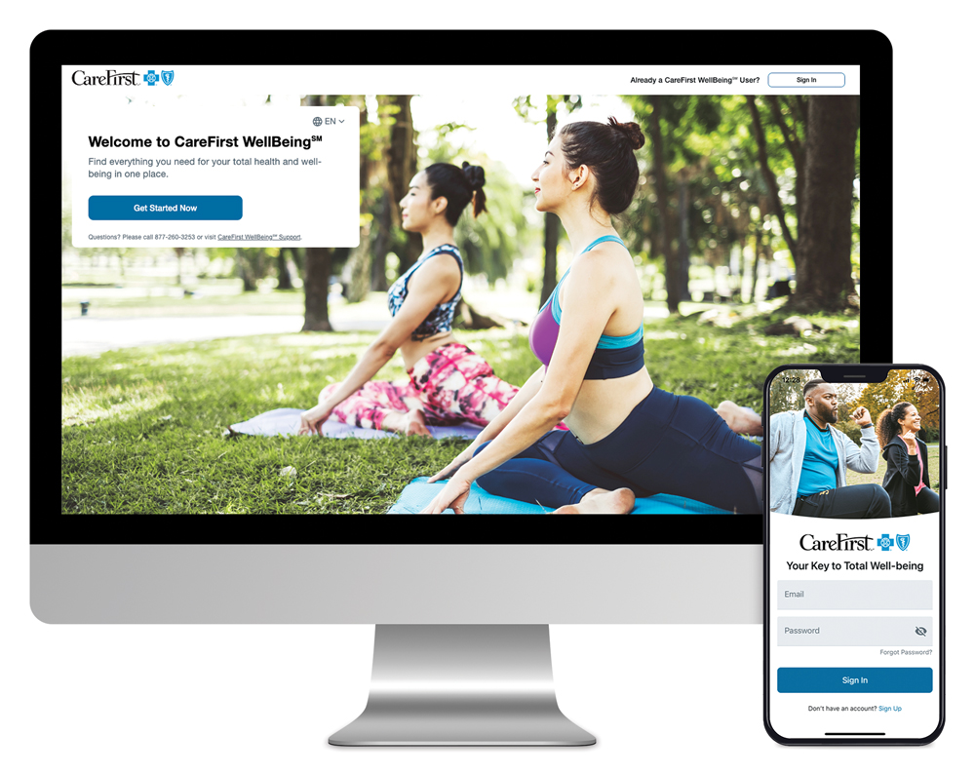






YOUR PERSONALIZED WELLBEING SOLUTION
Motivating digital resources anytime, anywhere:
RealAge®—Learn the physical age of your body, compared to your calendar age with the online health assessment
Personalized health timeline—Receive recommendations, health information and access well-being programs
Trackers—Connect your wearable devices or enter your own data to monitor sleep, steps, nutrition and more
Challenges—Get extra motivation for achieving your health goals
Health profile—Access your important health data all in one place
Get started today at carefirst.com/wellbeing
Unwinding—Break free from stress, unwind at the end of the day or ease into a restful night of sleep with meditation, streaming music and videos

Slide 14
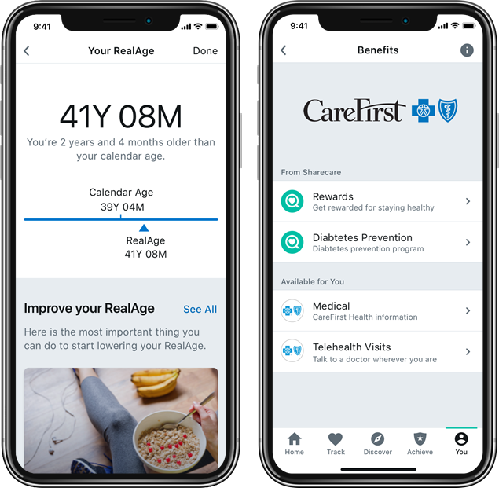
REALAGE® HEALTH ASSESSMENT
Do you know your RealAge?
Learn the physical age of your body, compared to your calendar age with this private online health assessment
Receive personalized recommendations based on your results
It helps you determine how old your body thinks you are based on your health and health habits
Up to 70% of overall health depends on how well you take care of yourself, so you have a lot of control over how young you actually are!

Slide 15




WELLNESS PROGRAMS
Explore special support and resources including:
Health coaching
Personal phone coaching provided by registered nurses and trained professionals focusing on stress management, chronic conditions and more
Weight management
Web- and app-based programs help you reach a healthier weight and reduce the risk of developing diabetes through gradual lifestyle changes that become lifelong habits
Tobacco cessation
21-day program provides digital coaching, peer-to-peer support and access to daily mindfulness activities and online tools
Financial well-being
Digital program includes videos, expert tips, easy-to-use tools and a step-by-step plan to help you reach your financial goals
Blue 365*
Exclusive health, wellness, travel, and experience discounts from top national and local retailers

Slide 16
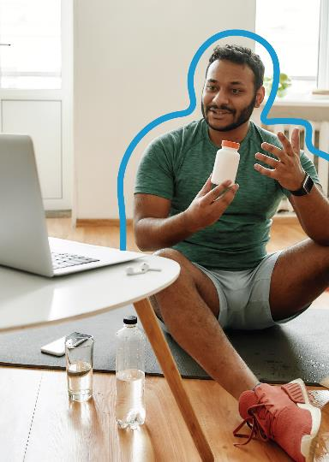


PERSONAL HEALTH COACHING
Access to personal health coaching, from losing weight or needing support to manage a chronic health condition, including:
Educational materials
1:1 support and encouragement
Online tools
Coaching allows your employees to:
Better understand health risks or conditions.
Recognize early warning signs that may require medical attention.
Understand doctors' recommendations, medications and treatments.
Gain more control over well-being.
Set goals to reach their best health.
Get started!
Questions?
Log in to or sign up for CareFirst WellBeing. Once logged in, select You, followed by Benefits. Next, click Health & Fitness and then Coaching.
Contact us at 877-515-2615.

Slide 17

WEIGHT MANAGEMENT & DPP
Noom Weight Management takes a psychology-based approach to help members develop and maintain healthy eating patterns and physical activity habits. The program includes daily informational articles, interactive challenges, food and weight logging and more.
Noom Diabetes Prevention Program (DPP) tailors to support individuals identified as "at-risk" for diabetes, Noom DDP gives participants access to features such as a weekly activity tracker, peer support and group interaction, and specially trained DPP lifestyle coaches.
Eat Right Now combines neuroscience and mindfulness tools to help members identify eating triggers and ride out cravings to change eating patterns. Key components include short daily video lessons, a dedicated digital coach, weekly live classes and online community support.
Get started!
Log in to or sign up for CareFirst WellBeing. Once logged in, select You, followed by Benefits. Next, click Health & Fitness and then Noom or Eat Right Now.

Slide 18

UNWINDING
Unwinding. Not your average meditation app.
Unwinding offers effective tools to teach individuals how the mind works and how to use mindfulness to manage stress and unwanted behaviors.
Available via the CareFirst Wellbeing App
Learn, Unwind, Sleep – three pillars each with effective tools and resources to help breakdown stress
Key Features
Learn: Mini short courses highlighting on the mind works
Unwind: Guided breathing exercises, mental "snack" breaks, visualization relaxation videos, meditation timer, and daily check-ins
Sleep: Sleep sounds, body scans, and background noise to promote sleep
Log in to or sign up for CareFirst WellBeing. Once logged in, select You, followed by Benefits. Next, click Relax & Reset and then Unwinding.
Get started!

Slide 19

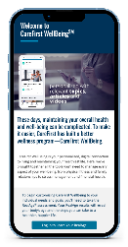
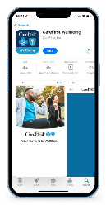
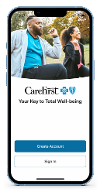
ACCESSING CAREFIRST WELLBEING
Get started today at carefirst.com/wellbeing
To register on a
mobile phone, visit carefirst.com/wellbeing and select "Get Started"
1
2
Download the CareFirst WellBeing application
3
Select "Create Account" and follow the prompts
Need Help? Contact CareFirst WellBeing Customer Support at 877-260-3253

Slide 20
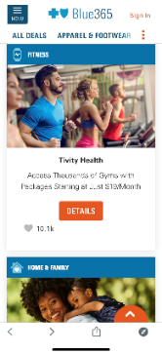
BLUE 365 DISCOUNT PROGRAM
Exclusive discounts from top retailers:
Apparel & Footwear (Reebok, Crocs, Sketchers, Moosejaw)
Fitness (equipment, memberships, race registration)
Hearing & Vision (hearing aids, Lasik, eye wear)
Home & Family (baby, pets, home office, finance)
Nutrition (Kind, Hungry Harvest, Blue Apron, Sunbasket, supplements)
Personal Care (oral care, grooming, skin care)
Travel (vacation, hotel, rental cars)
Get started!
Log in to or sign up for CareFirst WellBeing. Once logged in, select You, followed by Benefits. Next, click Money & More and then Wellness Discounts.

Slide 21
NEXT STEPS
Get Started With CareFirst WellBeing
Log in or Register at carefirst.com/wellbeing
Participate in Programs
Be Healthier!

Slide 22


