Slide 1


Washington Metropolitan Area Transit Authority Transit Employees' Retirement Plan
Keith M. Bullock
Ted W. Windsor

Slide 2


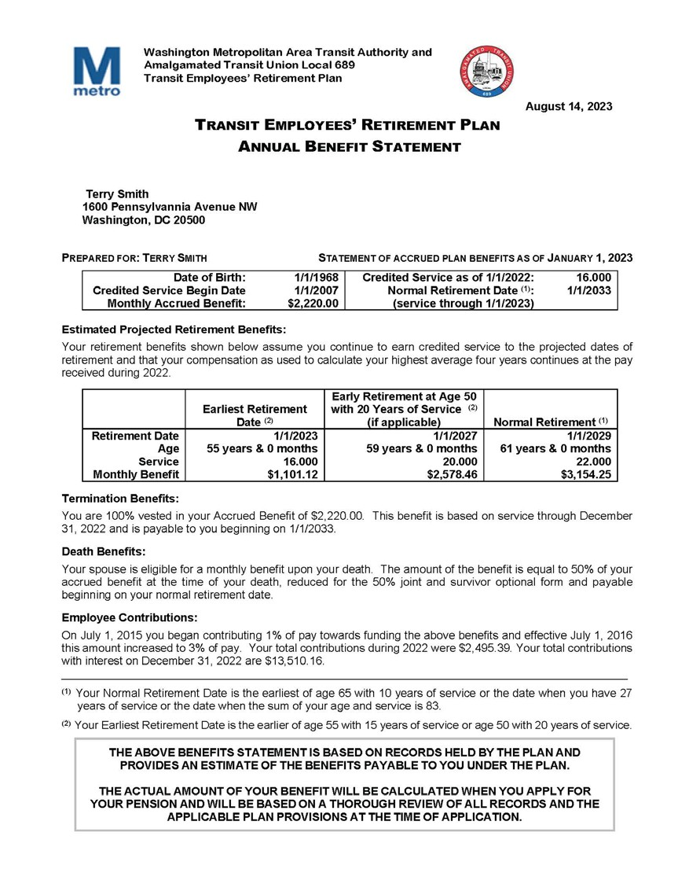
Your Benefit Statement

Slide 3



This is your “Accrued Benefit” based on your service and earnings through January 1, 2023, the statement date.
Accrued Benefits
It is an estimate of the benefits you will receive if you stop earning service and salary from WMATA on the statement date.

Slide 4
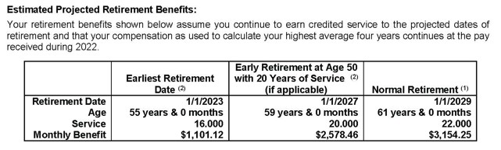
Estimated Projected Benefits
These are an estimate of your benefits projected to three different retirement ages.
These estimates assume you continue to earn service and
salary beyond the statement date until the Retirement Date shown.
Earnings are assumed to continue the same per year as your 2022 earnings. If your earnings in 2021 were greater than your 2022 earnings these projections might be lower than shown on your January 1, 2022 statement.

Slide 5
Calendar Year | Earnings (including overtime) | Average Compensation (on12/31 highest four years)
< 2018 *
2019 | $87,000
2020 | $89,000
2021 | $91,000
2022 | $93,000 | $90,000
2023 † | $93,000 | $91,500
2024 | $93,000 | $92,500
2025 | $93,000 | $93,000
2026 | $93,000 | $93,000
2027 | $93,000 | $93,000
2028 | $93,000 | $93,000
Calculation of Benefits Earnings Data
* Earnings in 2018 and earlier are used if greater
† Projected at amount for 2022

Slide 6
 | Date of Hire | Statement Date | Service
1. | Hire - 1/1/2007 | 1/1/2023 | 16 years
2. | Average Compensation |  | $90,000.00
3. | Multiplier * |  | 1.85%
4. | Monthly Accrued Benefit (#1 x #2 x #3)/12 |  | $2,220.00
Benefit is payable at Normal Retirement Age for your life only. * 1.85% for first 27 years, 1.95% for years above 27 years.
Accrued Benefit Calculation
 | Normal Retirement Eligibility | Date
1. | Age 65 with 10 years of service | 1/1/2033
2. | 27 years of service (on statement date) | N/A
3. | Age plus service = 83 - age 67 + 16 years (age at retirement, service on statement date) | 1/1/2035
4. | Earliest of (#1, #2 or #3) | 1/1/2033

Slide 7
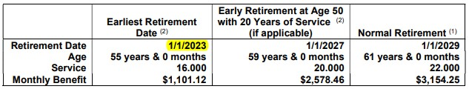
Projected Benefits Earliest Retirement Date
 | Earliest Retirement Date (projected age & service) | Date
1. | Age 55 with 15 years of service * | 1/1/2023
2. | Age 50 with 20 years of service † | 1/1/2027
3. | 27 years of service ‡ | 1/1/2034
4. | Earliest of (#1, #2 or #3) | 1/1/2023
* | 0.42% per month younger than age 65
† | 0.21% per month younger than 83 - service
‡ | No reduction

Slide 8
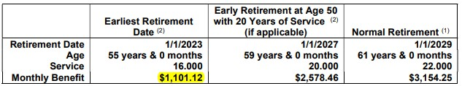
Projected Benefits Earliest Retirement Date
 | Date or Birth/Hire | Retirement Date | Age/Service
1. | 1/1/1968 | 1/1/2023 | 55 years
2. | 1/1/2007 | 1/1/2023 | 16 years
3. | Average Compensation |  | $90,000.00
4. | Multiplier |  | 1.85%
5. | Monthly Accrued Benefit (#2 x #3 x #4)/12 |  | $2,220.00
6. | Early retirement factor (120 months x 0.42%) |  | .5040
7. | Early retirement reduction (#5 x #6) |  | $1,118.88
8. | Early retirement benefit (#5 - #7) |  | $1,101.12

Slide 9
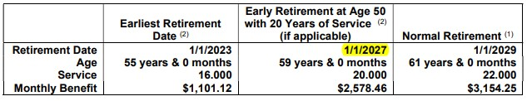
Projected Benefits Age 50 & 20 Retirement Date
 | Early Retirement Age 50 & 20 Years of Service (projected age & service) | Date
1. | Age 50 with 20 years of service † | 1/1/2027
† | 0.21% per month younger than 83 - service
 | Age on 1/1/2027 – 59 years of age
 | Age with 83 points – 63 years of age (83 – 20 years of service)
 | Reduction months = 63 years – 59 years times 12 = 48

Slide 10
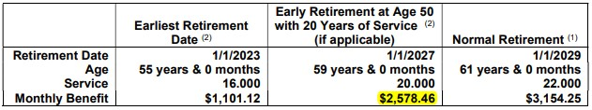
Projected Benefits Age 50 & 20 Retirement Date
 | Date of Birth/Hire | Retirement Date | Age/Service
1. | 1/1/1968 | 1/1/2027 | 59 years
2. | 1/1/2007 | 1/1/2027 | 20 years
3. | Average Compensation |  | $93,000.00
4. | Multiplier |  | 1.85%
5. | Monthly Accrued Benefit (#2 x #3 x #4)/12 |  | $2,867.50
6. | Early retirement factor (48 months x 0.21%) |  | .1008
7. | Early retirement reduction (#5 x #6) |  | $289.04
8. | Early retirement benefit (#5 - #7) |  | $2,578.46

Slide 11
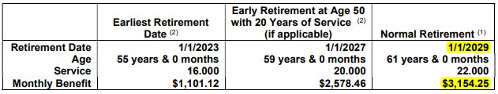
 | Normal Retirement Date (projected age & service) | Date
1. | Age 65 with 10 years of service | 1/1/2033
2. | 27 years of service | 1/1/2034
3. | Age plus service = 83 - age 61 + 22 years | 1/1/2029
4. | Earliest of (#1, #2 or #3) | 1/1/2029
Projected Benefits Normal Retirement Date
 | Date or Birth/Hire | Retirement Date | Age/Service
1. | 1/1/1968 | 1/1/2029 | 61 years
2. | 1/1/2007 | 1/1/2029 | 22 years
3. | Average Compensation |  | $93,000.00
4. | Multiplier |  | 1.85%
5. | Monthly Accrued Benefit (#2 x #3 x #4)/12 |  | $3,154.25

Slide 12
Your can use your unused sick leave to increase the amount of your benefit but not to qualify for a benefit. In the example below the retiring participant has one year of unused sick leave
 | Date of Birth/Hire | Retirement Date | Age/Service
1. | 1/1/1968 | 1/1/2023 | 55 years
2. | 1/1/1997 | 1/1/2023 | 26 years
3. | Unused sick leave |  | 1 year
 | Total Service | Eligibility | Accrual
4. |  | 26 years | 27 years
5. | Average Compensation |  | $96,000.00
6. | Multiplier |  | 1.85%
7. | Monthly Accrued Benefit (#4 col. 2 x #5 x #6)/12 |  | $3,996.00
8. | Months early [83 – 55 – 26 (eligibility years)] x 12 |  | 24 months
9. | Early retirement factor (24 months x 0.21%) |  | .0504
10. | Early retirement reduction (#7 x #9) |  | $201.40
11. | Early retirement benefit (#7 - #10) |  | $3,794.60
How Unused Sick Leave Works

Slide 13
Optional Forms of Benefits

Slide 14
Your benefit based on the formula.
  One – twelfth of Average Compensation times
    1.85% for each year of service up 27, plus
    1.95% for each year of service over 27.
  Is paid to you monthly for as long as you live and referred to as the Straight Life Annuity form of payment.
Optional forms change to way the benefit is paid and the amount of the benefit being paid.
What Is An Optional Form

Slide 15
Straight Life Annuity – Receive a monthly benefit for as long as you live, no further benefits after you die.
Joint & Survivor 50% – Receive a reduced monthly benefit for as long as you live, plus after your death a monthly benefit equal to 50% of your reduced benefit payable to your spouse for as long as they live.
Joint & Survivor 75% – Receive a reduced monthly benefit for as long as you live, plus after your death a monthly benefit equal to 75% of your reduced benefit payable to your spouse for as long as they live.
Guaranteed Period – Receive a reduced monthly benefit for as long as you live. If your die before you have received 120 monthly payments, your benefit will continue to your named beneficiary for the remainder of the 120 months.
Optional Forms Provided By TERP

Slide 16
Life With Cash Refund – The lump sum equivalent value of your original benefit is calculated. You receive a reduced monthly benefit for as long as you live. If you die before the sum of you reduced monthly benefits equals the lump sum equivalent, you receive the balance of the lump sum equivalent less the sum of the reduced monthly benefits received.
Level Income– A increased monthly benefit until age 65 followed by a reduced benefit at age 65. The benefit amounts are calculated such that your increased benefit until age 65 is the same as the sum of you reduced benefit after age 65 plus your Social Security benefit.
Optional Forms Provided By TERP cont.’

Slide 17
 | Description | Value
1. | Your age at retirement | 59 years
2. | Your spouse’s age at retirement | 57 years
3. | Joint & Survivor 50% conversion factor * | .8813
4. | Monthly Straight Life benefit | $4,000.00
5. | Monthly 50 % Joint & Survivor benefit payable for your life (#3 x #4) | $3,525.20
6. | Monthly benefit payable to your spouse after your death for the life of your spouse (50% of #5) | $1,762.60
* | This factor is based on actuarial tables contained in the Plan and is different depending on both your age and your spouse’s age at retirement
50% J&S
Example

Slide 18
 | Description | Value
1. | Your age at retirement | 59 years
2. | Guaranteed Period conversion factor * | .9544
3. | Monthly Straight Life benefit | $4,000.00
4. | Monthly Guaranteed Period benefit payable for your life with 120 monthly payments guaranteed | $3,817.60
For example, if you died after receiving 24 monthly payments of $3,817.60, the monthly benefit of $3,817.60 will continue to your designated beneficiary for an additional 96 months.
* | This factor is based on actuarial tables contained in the Plan and is different for each age at retirement
Guaranteed Period Example

Slide 19
 | Description | Value
1. | Your age at retirement | 59 years
2. | Life Annuity with Cash Refund lump sum equivalence factor * | 169.5127
3. | Life Annuity with Cash Refund conversion factor * | 0.9171
4. | Monthly Straight Life benefit | $4,000.00
5. | Lump sum equivalence (#4 x #2) | $678,050.80
6. | Monthly Life Annuity with Cash Refund benefit payable for your life and guaranteed that the sum of your monthly payments will not be less than the lump sum equivalence (#4 x #3) | $3,668.40
For Example:
7. | Payments you received before you died | 120 months
8. | Total payments received (including COLA increases) | $504,649.14
9. | Single sum benefit payable to your named beneficiary (#5 - #8) | $173,401.66
* | These factors are based on actuarial tables contained in the Plan and is different for each age at retirement
Life Annuity With Cash Refund Example

Slide 20
 | Description | Value
1. | Your age at retirement | 60 years
2. | Monthly Straight Life benefit | $4,000.00
3. | Monthly expected Social Security Benefit * | $1,850.00
4. | Social Security uplift factor | 0.5364
5. | Social Security uplift (#3 x #4) ‡ | $994.19
6. | Monthly Level Income benefit payable to age 65 (#2 + #5) | $4,994.19
7. | Estimated monthly Level Income benefit at age 65 before reduction (#6 increased for expected COLA 3.00%) † | $5,789.76
8. | Estimated monthly Level Income benefit at age 65 years old after reduction (#7 - #3) * | $3,939.76
* | The Social Security Benefit is an estimate obtained from the Social Security Administration and payable at age 65. This estimated amount will be used as the offset to your benefit at age 65 even if you elect to not take Social Security at age 65
† | This is an estimated benefit at age 65 before the reduction. Your actual COLA increased benefit at age 65 years will be used.
‡ | This factor is based on actuarial tables contained in the Plan and is different for each age at retirement
Level Income Example

Slide 21
Comparison of Straight Life Payments to Level Income Payments
$9,000 $8,000 $7,000 $6,000 $5,000 $4,000 $3,000 $2,000 $1,000 $0 60 61 62 63 64 65 66 67 68 69 70 71 72 73 74 75 Monthly Straight Life Benefit * Monthly Estimated Social Security Benefit Monthly Level Income Benefit † Monthly Level Income Plus Social Security
* | The accumulated value of the Straight Life Benefit at age 75 is $1,680,000.
† | The accumulated value of the Level Income Benefit at age 75 is $1,680,000.
Based on 3.00% COLA and 7.00% accumulation interest rate.
Level Income Example

