Slide 1
Find your healthy place
With care designed to help you thrive
2024 Benefits Presentation for Transit Employees Health & Welfare Plan Kaiser Permanente Medicare Advantage (HMO)
Darrien Banks | Retiree Consultant

Slide 2









Integrated care centered around you
KAISER PERMANENTE MEDICARE HEALTH PLANS
Primary care
Health
plan
Specialty care
Quality care begins with our integrated care delivery system, which offers you:
Care and coverage together in one package
A coordinated, connected care team
Many convenient services under one roof
Digital
care options
Pharmacy and labs
Connected care team
Electronic health data

Slide 3





Support for your total health and well-being
KAISER PERMANENTE MEDICARE HEALTH PLANS
Your doctor will build a care plan based on your needs and work with your care team to deliver personalized support.
Preventive care to keep you healthy
Specialty care when you need it
Support for ongoing conditions
Get care in your language — with multilingual doctors and phone interpretation in more than 150 languages.

Slide 4





KAISER PERMANENTE MEDICARE HEALTH PLANS
Your care, your way
With Kaiser Permanente, you can get care when, where, and how you want it.
Video Visits*
Connect with your doctor online. It’s convenient, safe, and secure, and it often doesn’t require a copay.
In person Same-day appointments
may be available.
Phone
Schedule a telephone appointment and get advice 24/7.
Email
Message your doctor anytime with
nonurgent questions.
App
Download our app to schedule appointments, manage prescriptions, see test results, and more.
*When appropriate and available.
.
Notes:
More places...

Slide 5




Care while traveling
KAISER PERMANENTE MEDICARE HEALTH PLANS
Since keeping you safe and healthy is our first priority, you’re covered for emergency and urgent care anywhere in the world. You can also get urgent care at MinuteClinic® in select CVS and Target stores when you’re traveling outside a Kaiser Permanente area.
How we make getting care while traveling more convenient:
Our Away from Home Travel Line is available 24 hours a day, 7 days a week. Call 951-268-3900 (TTY 711).
Visit kp.org/travel — a special section of
kp.org that’s focused on getting care while traveling
You can refill eligible prescriptions early in preparation
for your travel

Slide 6






Added support to help you thrive¹
KAISER PERMANENTE MEDICARE HEALTH PLANS
Wellness coaching by phone
On-site health education classes and support groups
Online healthy lifestyle programs, videos, podcasts, recipes, and more
Seasonal farmers markets
Reduced rates on specialty care services like acupuncture, chiropractic care, and massage therapy
Find convenient
Kaiser Permanente care near you at kp.org/facilities
¹These services aren’t covered under your health plan benefits and aren’t subject to the terms set forth in your Evidence of Coverage or other plan documents. These services may be discontinued at any time without notice. The products and services described above are neither offered nor guaranteed under our contract with the Medicare program. In addition, they are not subject to the Medicare appeals process. Any disputes regarding these products and services may be subject to the Kaiser Permanente grievance process.

Slide 7
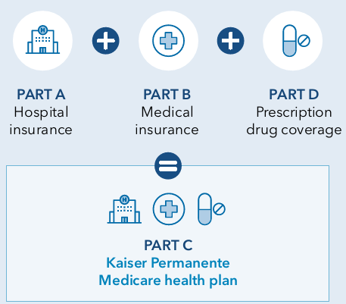
KAISER PERMANENTE MEDICARE HEALTH PLANS
Kaiser Permanente Medicare Advantage Plan (HMO)
To enroll into the Kaiser Permanente Medicare Advantage plan
You must be enrolled into Medicare Parts A and B through Social Security first and live within the Medicare Advantage Service Area
Privileged & Confidential

Slide 8





Summary of Benefits (01/01/24–12/31/24)
KAISER PERMANENTE MEDICARE HEALTH PLANS
Services | Transit Employees Health & Welfare Plan
Office Visits | $15 per visit
Lab/X-rays | No charge
Outpatient Surgery | $15 per visit
Inpatient Hospital Coverage | No charge
Emergency Services | $50 per visit
Ambulance Services | No charge
Prescription Drugs - Generic | $10 for up to a 30-day supply at a preferred pharmacy
Physical Therapy | $15 per visit

Slide 9


More ways to live healthy
KAISER PERMANENTE MEDICARE HEALTH PLANS
Kaiser Permanente offers additional resources and benefits to our Medicare Advantage members, including:
Silver&Fit® fitness benefit
Vision benefits
BrainHQ
Advance health care directives online tools and classes
Virtual Care
Thriving After 60
Preventive Dental benefits
Transportation benefits

Slide 10

THANK YOU
for your time today!
KAISER PERMANENTE MEDICARE HEALTH PLANS
Kaiser Permanente is an HMO plan with a Medicare contract. Enrollment in Kaiser Permanente depends on contract renewal.
You must reside in the Kaiser Permanente Medicare health plan service area in which you enroll.
April 2024

