Slide 1
Tehw Educational seminar
April 27, 2024

Slide 3
Medical Products
Blue Choice HMO
Blue Choice Advantage with PPO Overlay
Medicare Advantage
Preferred Dental
Preferred Dental with Ortho
Notes:
Master slide: Title and Three Column Content

Slide 4
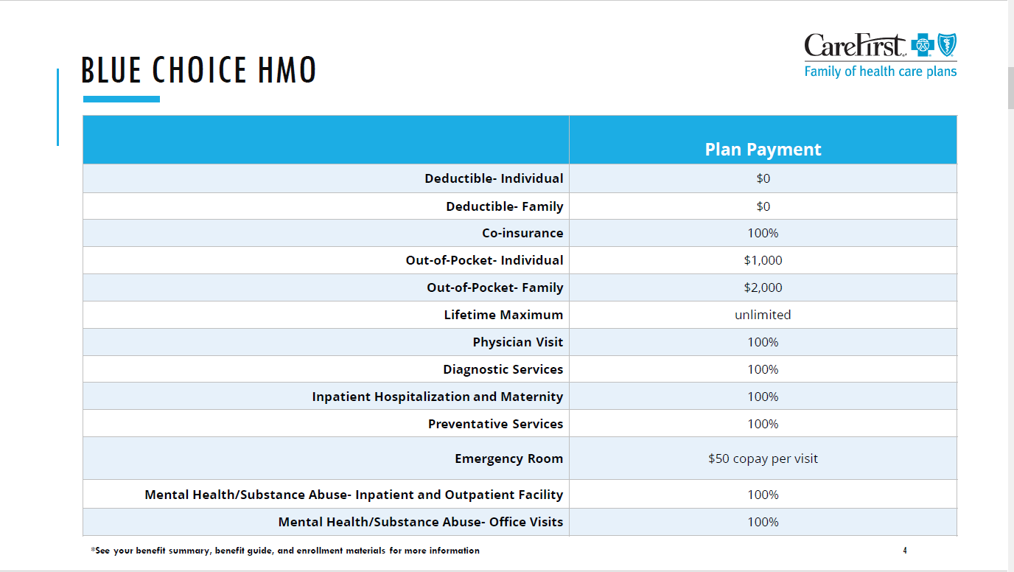

Slide 5
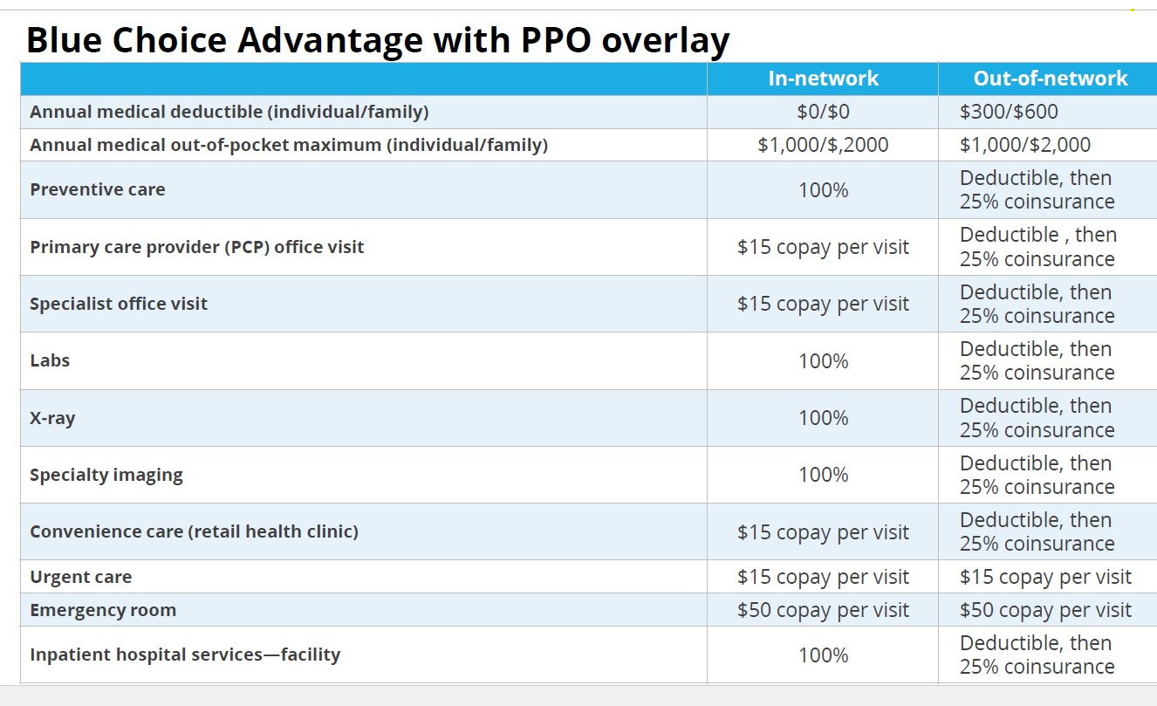

Slide 6
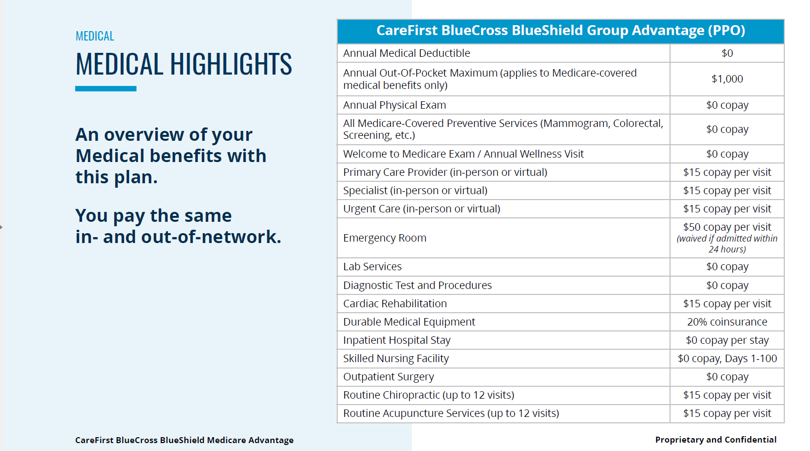

Slide 7








OFFERING
Virtual-first care centered around the patient:
A comprehensive and centralized virtual-first care offering to provide
faster and easier access to better affordable care for every patient
ADVANCED PRIMARY CARE
SPECIALIZED CARE
Preventive care
Care navigation
Chronic care
Episodic care
Lactation¹
Nutrition¹
URGENT CARE
MENTAL HEALTH CARE
No appointment needed
24/7/365
Mental Health Counseling
Therapy¹
Psychiatry¹
1: available starting Q4 2023

Slide 8
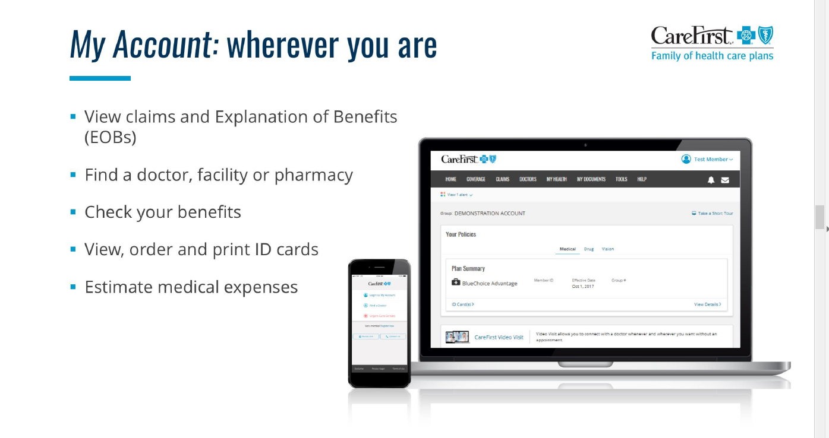

Slide 9

CAREFIRST WELLBEING
Notes:
Thanks, Emma! and hello everyone! Thanks for joining today
My name is Stephanie Freeburger and I’m a wellbeing consultant here at CareFirst.
Today I’m going to walk you through the CareFirst WellBeing app and show you how to access all of the great tools and resources that you can use to support your wellness journey.
wanted to let you know that as a special thank you we will be drawing a winner from today’s attendee list to receive a fun wellness prize. Just our way of saying thank you for joining today to learn about your wellness program.
So, lets go ahead and get started.
-----------
If you were able to catch any of the relaxation video I was just showing, its called Forest Bathing and can be found in the inspirations section of the CareFirst WellBeing app. More on where to find that and many more in just a moment.

Slide 10
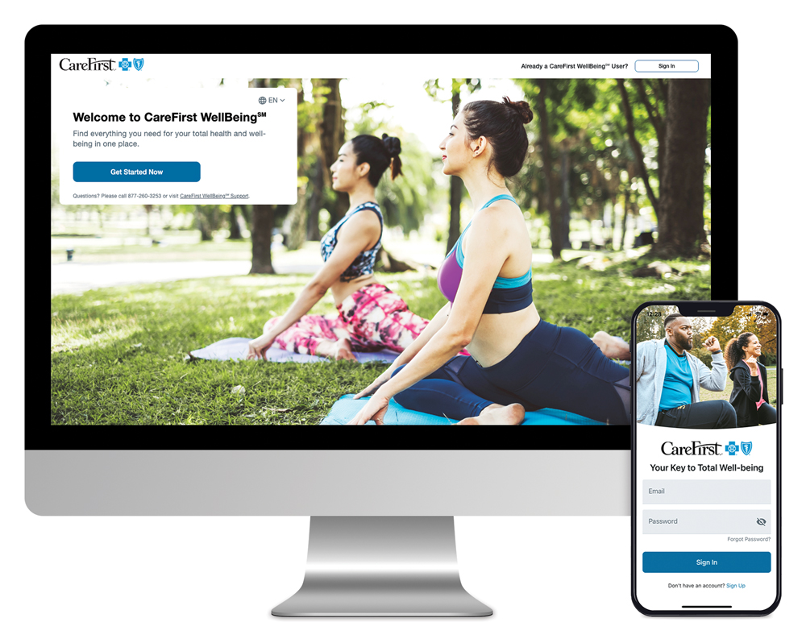






YOUR PERSONALIZED WELLBEING SOLUTION
Motivating digital resources anytime, anywhere:
  RealAge®—Learn the physical age of your body, compared to your calendar age with the online health assessment
  Personalized health timeline—Receive recommendations, health information and access well-being programs
  Trackers—Connect your wearable devices or enter your own data to monitor sleep, steps, nutrition and more
  Challenges—Get extra motivation for achieving your health goals
  Health profile—Access your important health data all in one place
Get started today at carefirst.com/wellbeing
  Unwinding—Break free from stress, unwind at the end of the day or ease into a restful night of sleep with meditation, streaming music and videos

Slide 11
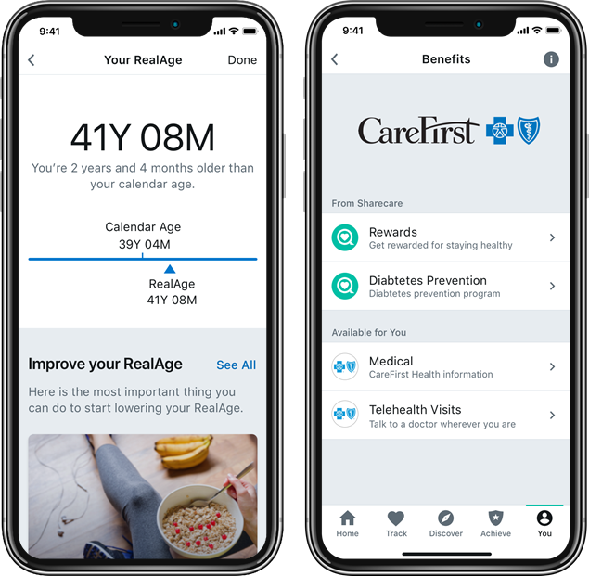
REALAGE® HEALTH ASSESSMENT
Do you know your RealAge?
Learn the physical age of your body, compared to your calendar age with this private online health assessment
Receive personalized recommendations based on your results
It helps you determine how old your body thinks you are based on your health and health habits
Up to 70% of overall health depends on how well you take care of yourself, so you have a lot of control over how young you actually are!

Slide 12





WELLNESS PROGRAMS
Explore special support and resources including:
Health coaching
Personal phone coaching provided by registered nurses and trained professionals focusing on stress management, chronic conditions and more
Weight management
Web- and app-based programs help you reach a healthier weight and reduce the risk of developing diabetes through gradual lifestyle changes that become lifelong habits
Tobacco cessation
21-day program provides digital coaching, peer-to-peer support and access to daily mindfulness activities and online tools
Financial well-being
Digital program includes videos, expert tips, easy-to-use tools and a step-by-step plan to help you reach your financial goals
Blue 365*
Exclusive health, wellness, travel, and experience discounts from top national and local retailers

Slide 13
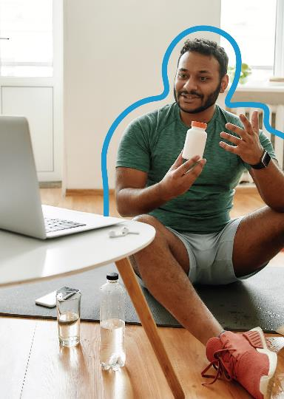


PERSONAL HEALTH COACHING
Access to personal health coaching, from losing weight or needing support to manage a chronic health condition, including:
Educational materials
1:1 support and encouragement
Online tools
Coaching allows your employees to:
Better understand health risks or conditions.
Recognize early warning signs that may require medical attention.
Understand doctors' recommendations, medications and treatments.
Gain more control over well-being.
Set goals to reach their best health.
Get started!
Questions?
Log in to or sign up for CareFirst WellBeing. Once logged in, select You, followed by Benefits. Next, click Health & Fitness and then Coaching.
Contact us at 877-515-2615.

Slide 14

WEIGHT MANAGEMENT & DPP
Noom Weight Management takes a psychology-based approach to help members develop and maintain healthy eating patterns and physical activity habits. The program includes daily informational articles, interactive challenges, food and weight logging and more.
Noom Diabetes Prevention Program (DPP) tailors to support individuals identified as "at-risk" for diabetes, Noom DDP gives participants access to features such as a weekly activity tracker, peer support and group interaction, and specially trained DPP lifestyle coaches.
Eat Right Now combines neuroscience and mindfulness tools to help members identify eating triggers and ride out cravings to change eating patterns. Key components include short daily video lessons, a dedicated digital coach, weekly live classes and online community support.
Get started!
Log in to or sign up for CareFirst WellBeing. Once logged in, select You, followed by Benefits. Next, click Health & Fitness and then Noom or Eat Right Now.

Slide 15

UNWINDING
Unwinding. Not your average meditation app.
Unwinding offers effective tools to teach individuals how the mind works and how to use mindfulness to manage stress and unwanted behaviors.
Available via the CareFirst Wellbeing App
Learn, Unwind, Sleep – three pillars each with effective tools and resources to help breakdown stress
Key Features
Learn: Mini short courses highlighting on the mind works
Unwind: Guided breathing exercises, mental "snack" breaks, visualization relaxation videos, meditation timer, and daily check-ins
Sleep: Sleep sounds, body scans, and background noise to promote sleep
Log in to or sign up for CareFirst WellBeing. Once logged in, select You, followed by Benefits. Next, click Relax & Reset and then Unwinding.
Get started!

Slide 16

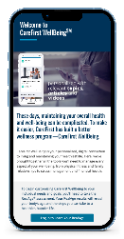
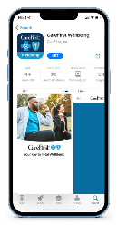
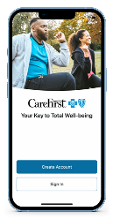
ACCESSING CAREFIRST WELLBING
Get started today at carefirst.com/wellbeing
To register on a
mobile phone, visit carefirst.com/wellbeing and select "Get Started"
1
2
Download the CareFirst WellBeing application
3
Select "Create Account" and follow the prompts
Need Help? Contact CareFirst WellBeing Customer Support at 877-260-3253

Slide 17

BLUE 365 DISCOUNT PROGRAM
Exclusive discounts from top retailers:
Apparel & Footwear (Reebok, Crocs, Sketchers, Moosejaw)
Fitness (equipment, memberships, race registration)
Hearing & Vision (hearing aids, Lasik, eye wear)
Home & Family (baby, pets, home office, finance)
Nutrition (Kind, Hungry Harvest, Blue Apron, Sunbasket, supplements)
Personal Care (oral care, grooming, skin care)
Travel (vacation, hotel, rental cars)
Get started!
Log in to or sign up for CareFirst WellBeing. Once logged in, select You, followed by Benefits. Next, click Money & More and then Wellness Discounts.

Slide 18
NEXT STEPS
Get Started With CareFirst WellBeing
  Log in or Register at carefirst.com/wellbeing
Participate in Programs
Be Healthier!

Slide 19


